Slide 1
Stochastic Modelling of Oil and Gas Economics 2018 Industrial Problem Solving Workshop Michael Morgan – GLJ Petroleum Consultants

Slide 2
Who We Are and What we Do
Our core competency is to independently evaluate, from the well on up, how much oil and gas E&P companies own, how this will likely be extracted and how much money this is worth.
We are one of the largest petroleum evaluation firms in the world
Our evaluations cover companies that range in size from startups with five employees to the largest independents and cover every type of oil or gas play from offshore conventional, to tertiary recovery, to SAGD to multi-frac’d unconventional.
Our evaluations are used for mergers, acquisitions, stock market filings, pipeline supply studies and other key investment decisions
With approximately 100 employees, many of them with decades of experience within the firm, we can analyze multi-billion dollar assets within weeks, often with little notice.
We were established 1972 and are located in Calgary, Alberta; that’s our home turf, but we analyze companies and assets that span the world.

Slide 3
How our work is changing
Development of oil and gas resources used to entail drilling a relatively small number of wells into potential oil or gas “traps”. These traps might not contain hydrocarbons.
Drilling was economically risky, but the traps had clear limits and properties that could be determined with reasonable certainty once the wells were drilled.
In both Canada and the US, these types of opportunities have already been exploited. Development is shifting to low-grade regionally extensive oil and gas deposits.
Drilling “dry holes” is less likely, but requires a large number of wells over a large number of years in oil and gas pools with poorly defined limits and uncertain but correlated properties.
Let’s look at an example of what is being developed and current analysis techniques…

Slide 4
The Montney is Becoming Canada’s Main Gas Supply
It is the largest (and growing) supply for gas in British Columbia
British Columbia is becoming a larger fraction of Canada’s gas supply
Montney
British Columbia

Slide 5
The Montney is Becoming Canada’s Main Gas Supply
The overall result is that, over ten years, the Montney is now responsible for about a third of Canada’s gas supply
BC Montney
Alberta Montney

Slide 6
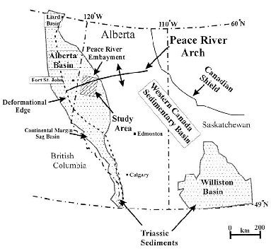

Extent of WCSB Triassic Sediments
Toad River
Canmore
Panek 2000

Slide 7
Billions and Billions of Dollars are Transacted
Seven Generations IPO
$0.93 Billion
Petronas buys Progress
$5.50 Billion
Mitsubishi/EnCana JV
$2.90 Billion
Tourmaline IPO
$0.23 Billion
Shell buys Duvernay Oil
$5.9 Billion
Arc Resources buys Star Oil and Gas in 2003
$0.71 Billion

Slide 8
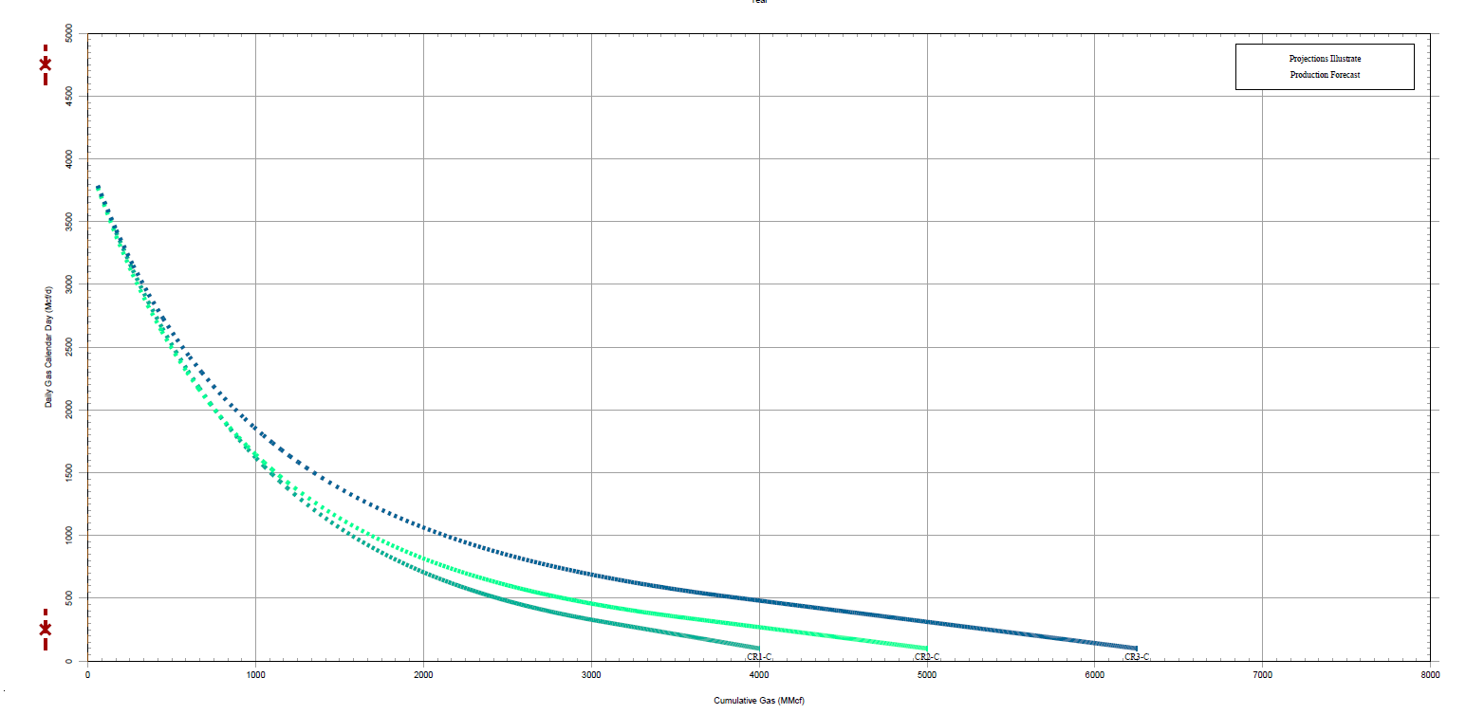
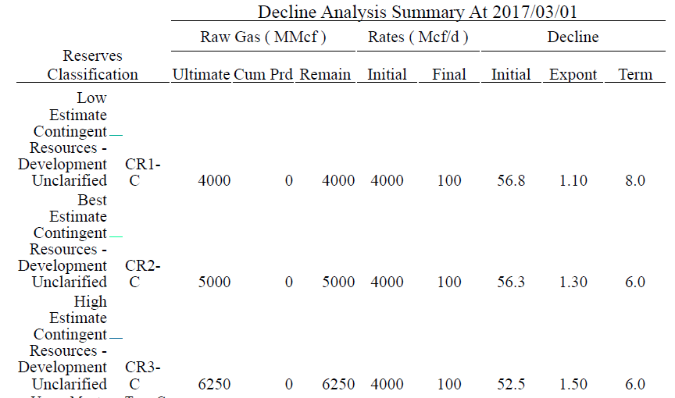
Wells are Forecast using “TYPE CURVEs”
Based on existing Groundbirch wells and nearby Pengrowth, Shell and Crew West Septimus Upper Montney wells. 2500m horizontal length well and 10 wells per section(1205 wells in Groundbirch).

Slide 9
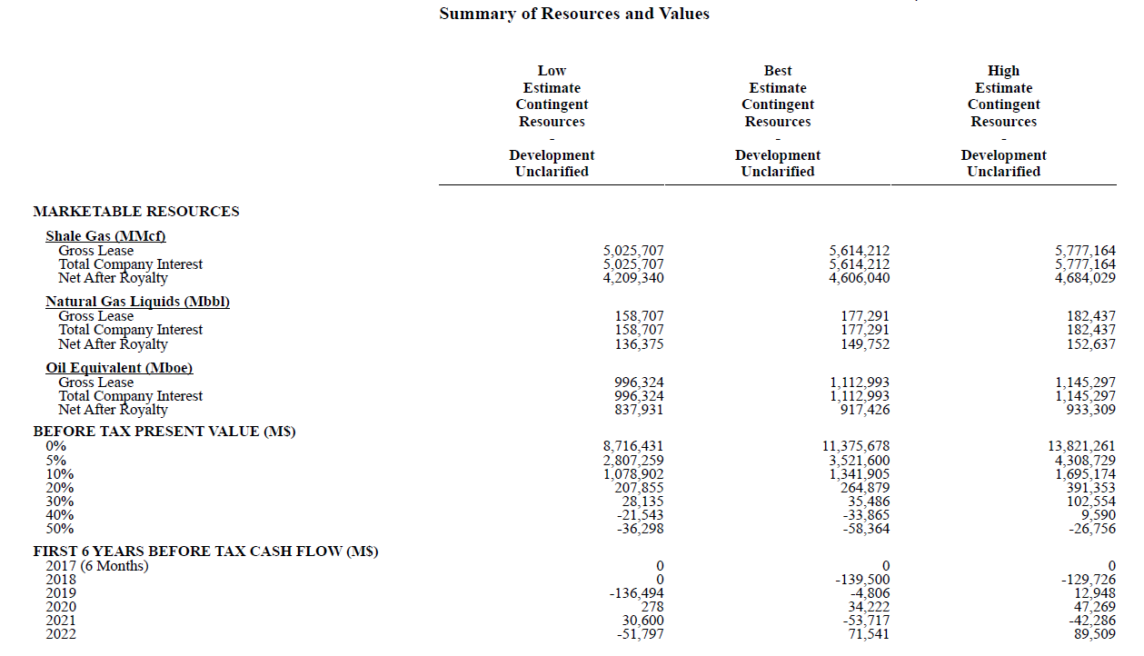
ECONOMIC Analysis is Conducted using Discounted Cash Flows

Slide 10
Economic Returns are Dominated by Commodity Prices
ROR ~35%

Slide 11
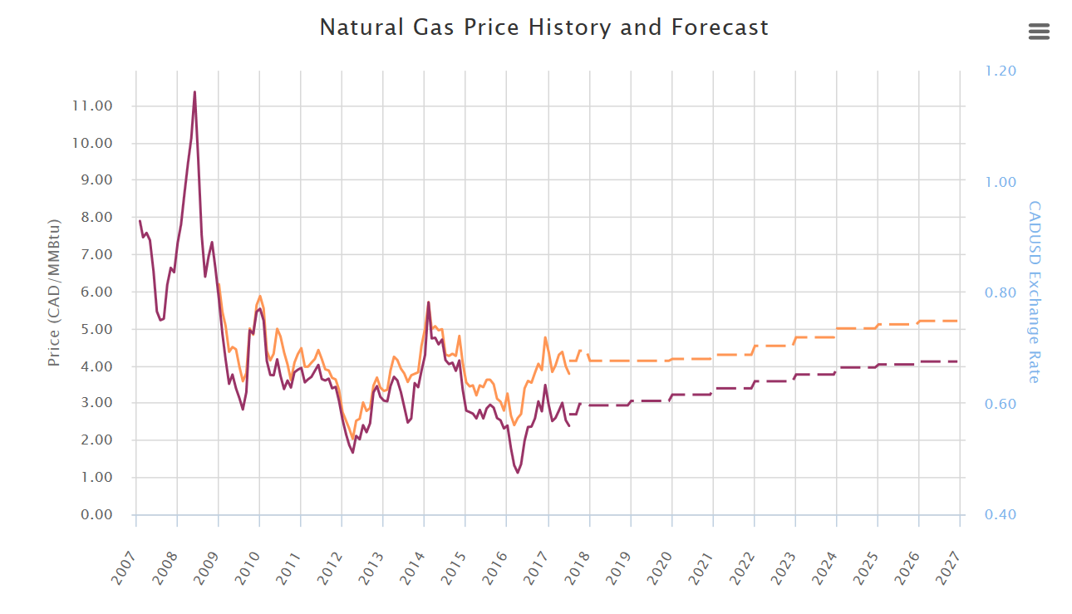
Deterministic forecasts are Used for Commodity Prices
Based on GLJ AECO price forecast and 1100btu/scf heating value
HENRY HUB
AECO

Slide 12
Rate of Return
Notes:
Roughly $30 oil

Slide 13
Economic Risk Analysis often Reverts to Simple Price Matrices
We could reproduce Seven Generation’s reported economics: they have a good rates of return if oil prices stay at CAN$50/bbl
Returns are not as robust as some other areas if oil is $30/bbl
The tables below show simplified single-well economic runs

Slide 14
analysis We Think Industry Will Need in the Future
As more and more of industry’s workload shifts to resource play development it will become more interested in the mechanics of how uncertainty is treated. For example, using a simple “rule of thumb” 15 or 20% spread between forecasts may not suffice, nor will ignoring correlations between well results when doing statistical aggregation.
The problems I submitted all address methods of generating probabilistic forecasts, whether for pipeline supply studies, price decks, production profiles or the economics of constructing deep-cut facilities.
In this project, we are interested four different general areas:
Econometrics
Real Options Analysis
Geographic Correlation and Temporal Uncertainty
SDE Solutions to PDEs
Stochastic models provide an approach to these problems by treating certain unknown parameters as random variables and performing an in-depth analysis that takes into account this uncertainty. In particular, stochastic differential equations (SDEs) are one useful method whose application are of interest to oil and gas economic problems.

Slide 15
1) Econometrics
Most econometric analysis has used price series external to Canada such as the price of West Texas Intermediate (WTI) oil or of gas traded at Henry Hub. However, Canadian producers most often receive revenues based on the price of oil at various refineries in Edmonton or on the price of gas at either the AECO trading hub or at Station 2 in British Columbia.
Current practice often models Canadian prices to be simple linear functions of world benchmark prices. However, such models do not allow different mean reversion rates, volatilities or correlations, all of which may be necessary to reflect fundamental physical and economic differences specific to the Canadian market.
A successful solution would propose an analytical framework suited to the observed dynamics of Canadian energy commodity prices; statistical work supporting the inclusion or exclusion of various factors or terms; calculation of best estimate parameters; forecasts showing equi-probable future outcomes and any computer code required for these calculations.
Data for various Canadian price series can be provided by GLJ Publications.

Slide 16
A Sample Single-Commodity Model
Real prices don’t increase without limit.
Instead, they appear to drift back to normal after any dramatic change (up or down).
An Ornstein-Uhlenbeck Model captures the basics of this behaviour.
Change in Price
Difference from Average
Error
How Fast
How Variable

Slide 17
Model Parameters (Real Prices $CDN)
 | Average | Volatility | Half-Life
WTI Brent Edmonton Light Sweet Edmonton Condensate Edmonton Mixed Sweet Cromer Light Hardisty Heavy Edmonton Butane Edmonton Propane Henry Hub AECO Alberta Plantgate Station 2 | 87.04 92.07 85.13 90.71 84.58 80.49 55.48 69.93 53.29 4.77 4.78 4.53 4.66 | 29.91% 27.22% 35.09% 30.76% 35.17% 37.46% 78.24% 37.76% 41.04% 47.88% 47.43% 48.90% 50.76% | 1.334 1.029 1.442 1.140 1.434 1.513 2.654 2.043 2.353 0.425 0.576 0.567 0.644
Since 2005, the less you are like Brent or AECO/HH,
the lower and the more volatile your price.

Slide 18
2) SDE Solutions to PDEs
Simple PDE production models are commonly used for economic calculations, especially PDEs with compact analytical solutions. For example, late life wells produced with a constant pressure are often modelled using a simple exponential relationship, dq/dt = -Dq where q is the flow rate and D is a constant rate of decline. The parameters of these models cannot be precisely determined a priori, nor can they be estimated with precision due to the difficulty in precisely controlling producing conditions for accurate flow measurements. As such, forecasts are uncertain.
Our goal here is to model the parameters as stochastic processes and solve the resulting stochastic differential equations using Ito's Lemma. These can then be used to compare with data from actual wells to evaluate how well these stochastic models are working.
Common PDEs used to forecast production include the following:
Arps:
dq/dt = -(D₁/q₁^{b}) q^{b+1}
Power Law Exponential:
dq/dt = -( D∞ + D₁t^{-(1-n)}) q
Stretched Exponential:
dq/dt = -(n/t) (t/τ)^{n} q
Logistic Growth:
dq/dt = -{a-an+(1+n)t^{n}}/{t(a+t^{n})} q
Duong:
dq/dt = -(mt⁻¹-at^{-m}) q
A successful solution would propose analytical stochastic solutions to a selection of the common PDEs models; calculation of best estimate parameters; forecasts showing equi-probable future production outcomes; forecasts showing the distribution of expected future revenues and any computer code required for these calculations.
Historical production data and typical economic parameters, including royalty models, can be provided by GLJ Petroleum Consultants.

Slide 19
Simple Production Forecast: The Short Version
This complex production behavior is approximated by the use of a two stage Arps decline
Stage one is a super-harmonic decline with an “n” exponent that is commonly set equal to 1.4
Stage two is an exponential decline
We continuously examine the validity of this model

Slide 20
Rigorous Decline Parameter Distributions
We are looking to also rigorously calculate the confidence interval (at the well level) for the model parameters
With increasing production, models start converging to sensible best-fit parameters
Here be Dragons! With little production history, most any model can be fit to the data, even models with farcical inputs

Slide 21
3) Geographic Correlation and Temporal Uncertainty
Nearly all energy resources are aggregated using fixed infrastructure. However, energy supplies are nearly always spatially correlated and have a temporal quality. Good wells are clustered together and they produce at decline rates. Wise investment decisions on fixed infrastructure will need to consider both spatial and temporal patterns.
It would be beneficial to have a model for pipeline supply that considers a catchment area within which discrete input sources are located (ie gas wells). These input sources are not constant: they decline over time according to uncertain spatially correlated parameters. Such a model should calculate the distribution of number of point sources required, and the pace of adding them, to maintain a constant supply to the pipeline. Such a model should also consider how the distribution changes with increasing certainty, both in terms of the underlying (spatially varying) productivity of the area and in terms of the uncertainty of the decline parameters.
Such a model for pipeline supply would be beneficial when considering development within relatively untested areas, thereby better informing investment decisions and development strategies.
Monte-Carlo methods have been employed, but convergence can be slow and the correlation structures hard to state compactly.
A successful solution would propose an analytical framework; statistical work supporting the choice of spatial and temporal models; forecasts of various development scenarios, the distribution of point sources required to maintain a constant supply and the impact of certainty of model parameters on this distribution; and any computer code required for these calculations.
Historical data for various catchment areas can be provided by GLJ Petroleum Consultants.

Slide 22
Regional Trends: Well Productivity
Normalized peak gas rate per 100T frac equivalent.
This does not account for produced liquids.
Notes:
ADD CATCHMENT AREAS.

Slide 23
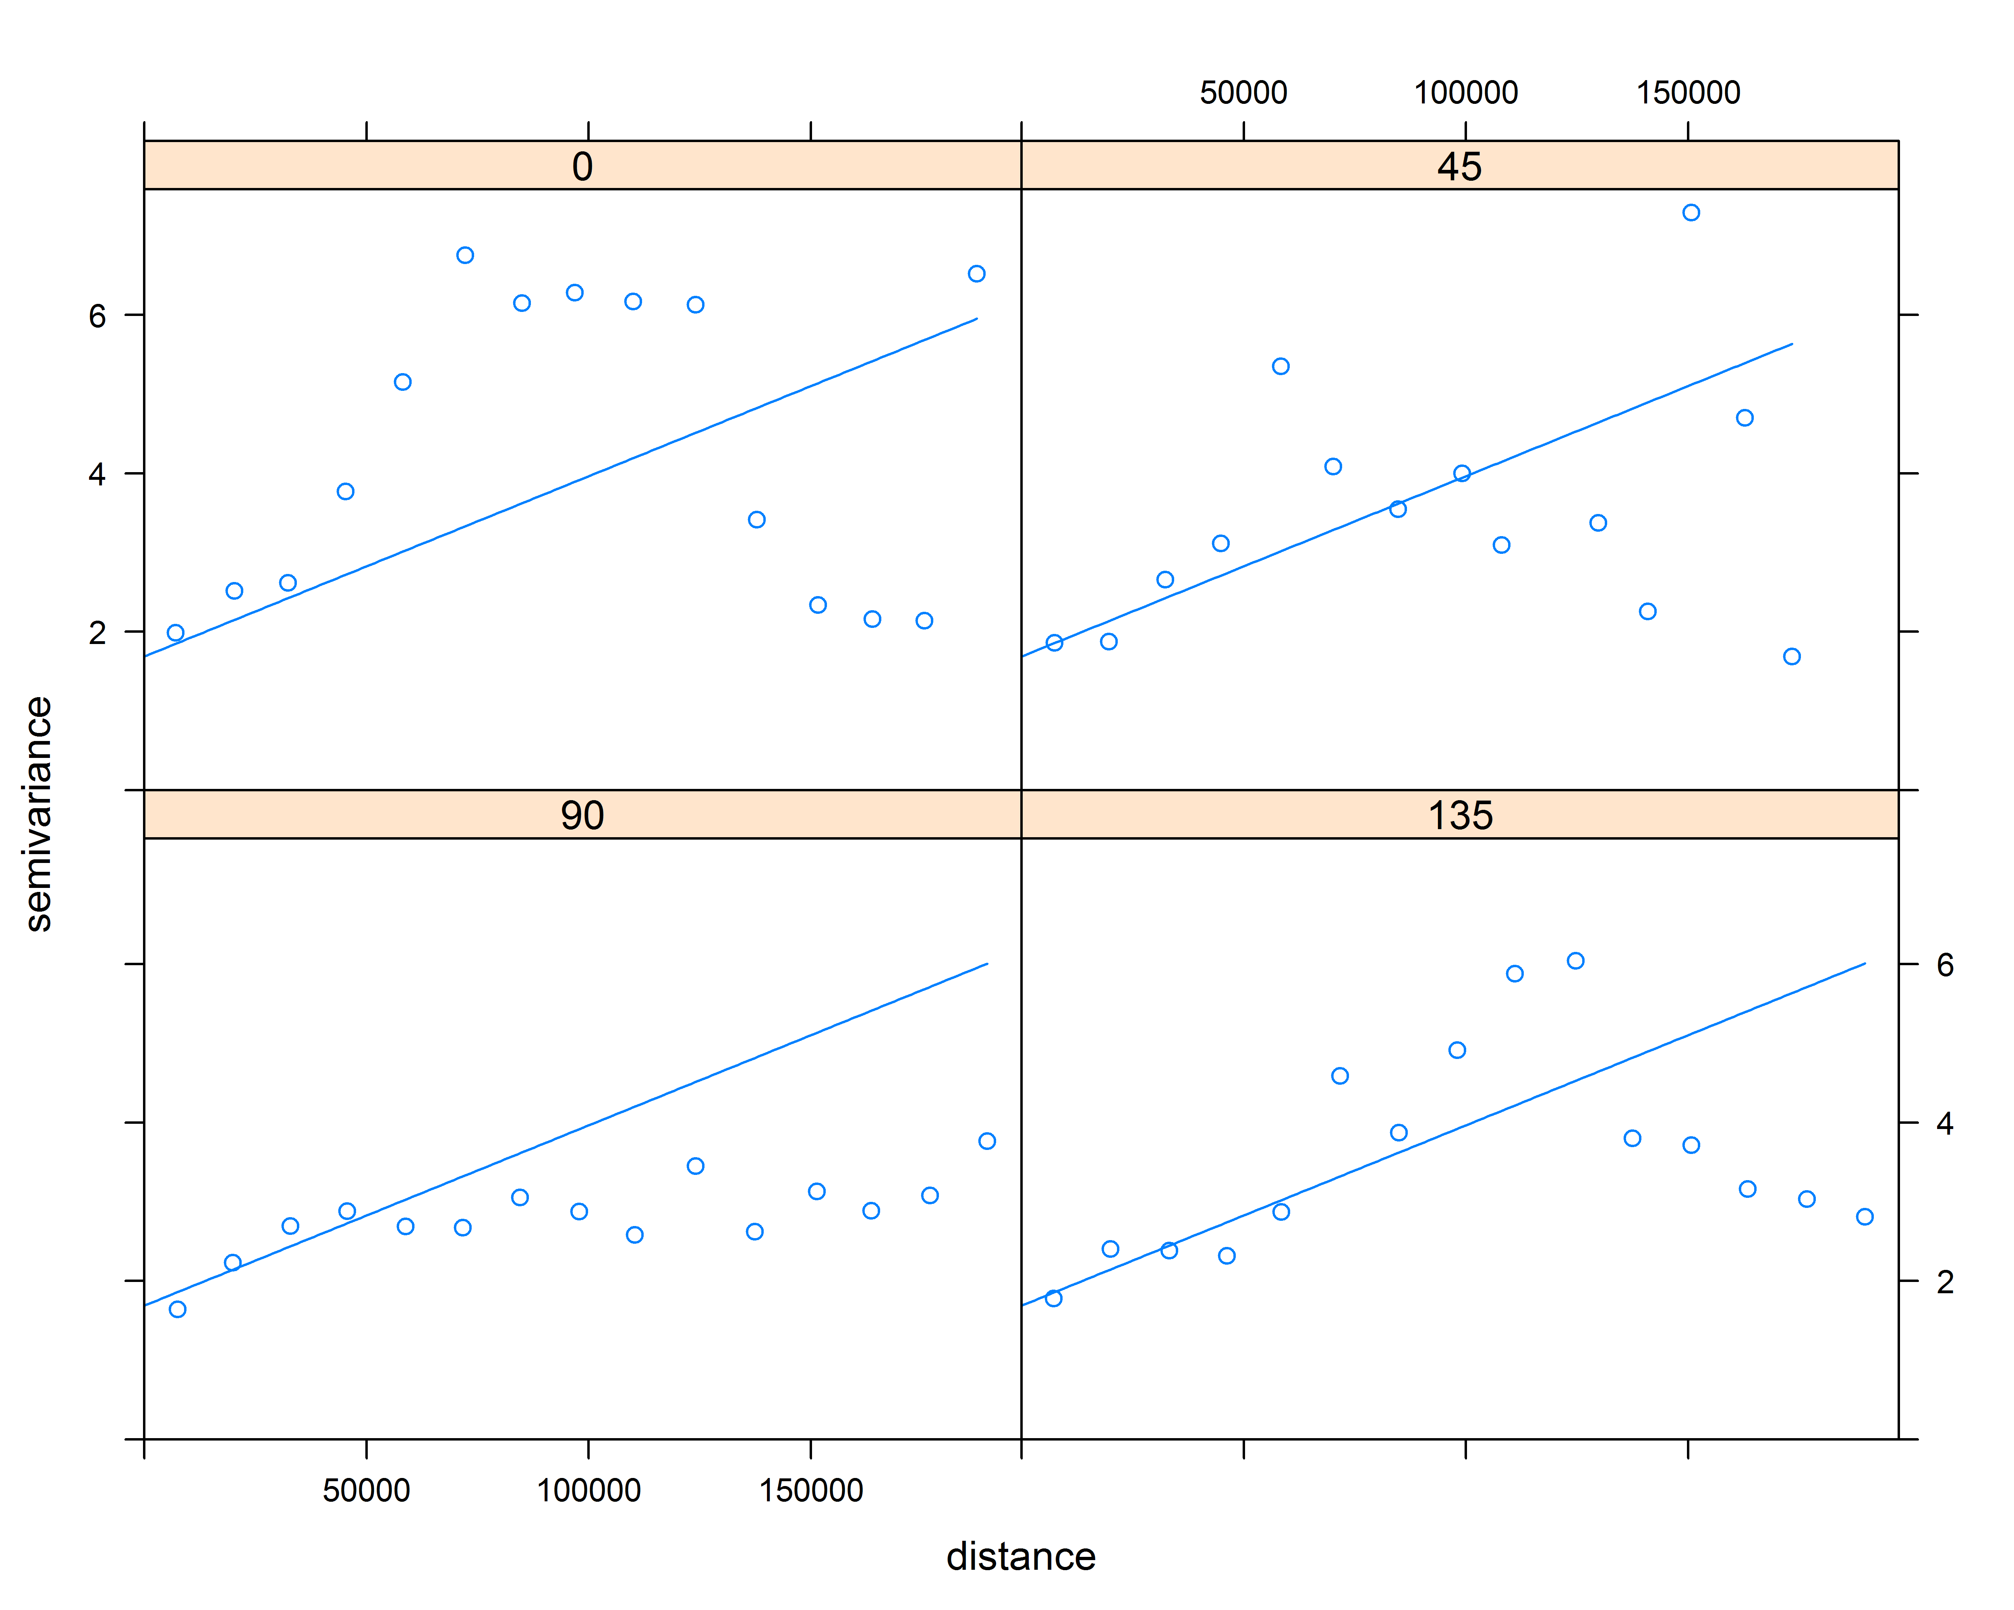
Montney Variograms

Slide 24
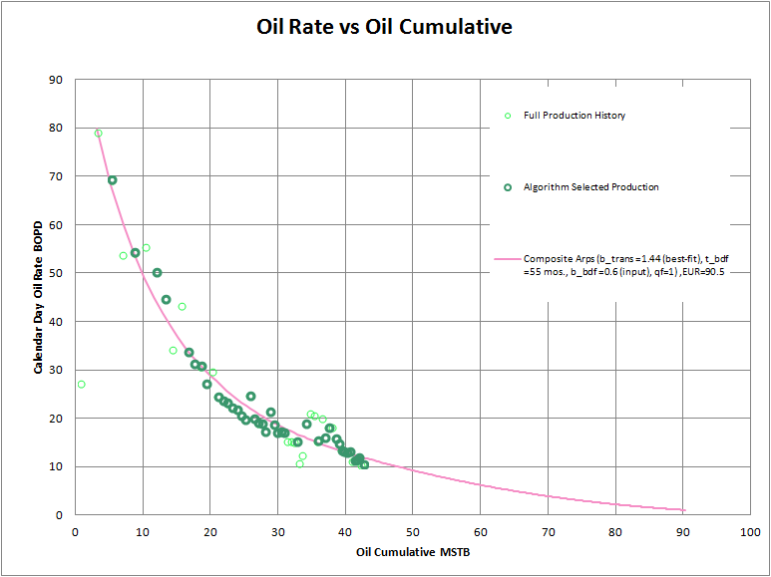
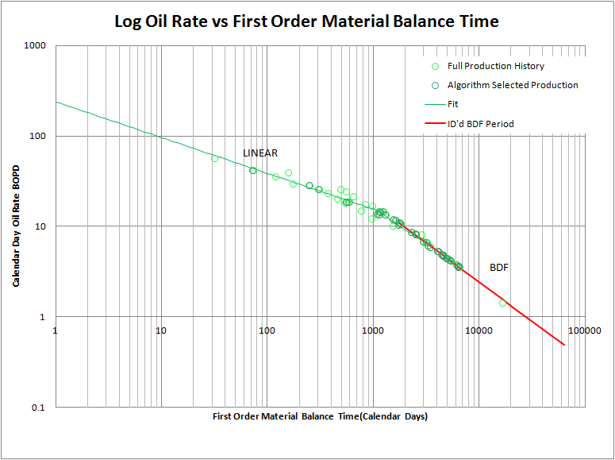
Production forecasts
Two-stage Arps hyperbolic declines
Bootstrap resampling
Consideration of physical system

Slide 25
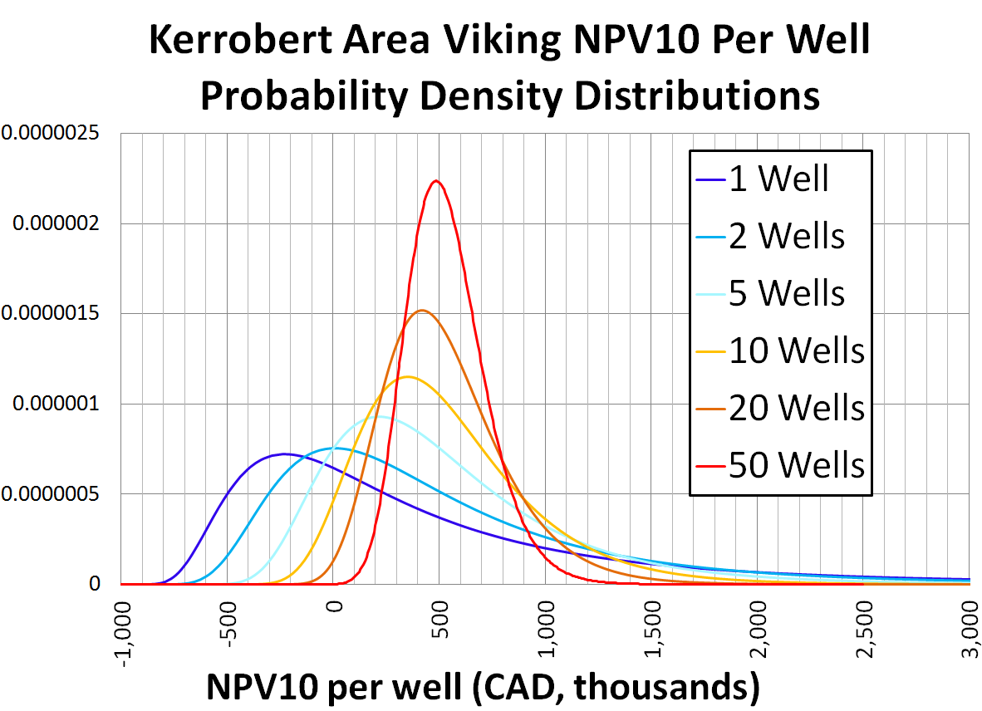
Expectations tighten with more wells
# Wells | P50
1 | $137k
2 | $308k
5 | $405k
10 | $478k
20 | $497k
50 | $523k
Here, every well drilled is geostatistically independent from every other well (“shotgun blast” scenario)

Slide 26
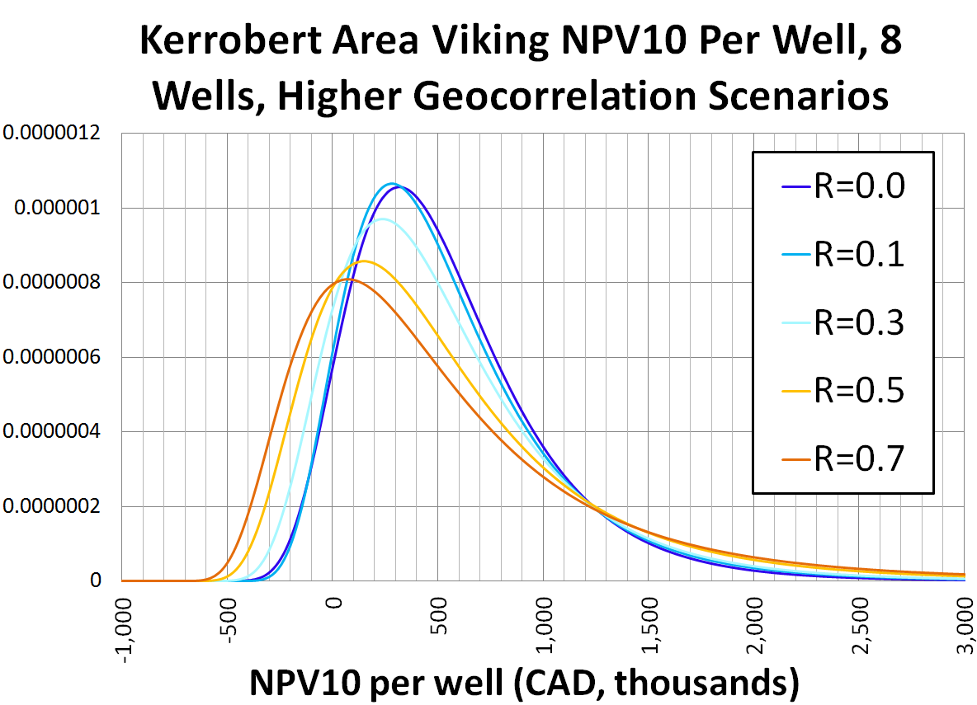
Expectations don’t tighten as much if wells are all drilled in one small area
R=0.0 P50: $459k
R=0.1 P50: $454k
R=0.3 P50: $425k
R=0.5 P50: $393k
R=0.7 P50: $345k
If 8 wells are all drilled in the same section, then some of the “law of averages” effect is lost
Kerrobert within one mile

Slide 27
4) Real Options Analysis
In designing gas processing plants an important factor is the degree to which various higher weight hydrocarbons are separated from methane. This is commonly done by chilling the gas until the higher weight hydrocarbons condense and can be removed as a liquid. This allows the higher weight hydrocarbons to be sold as liquids (taking advantage of higher liquids prices) instead of a gas. However, running gas plants at lower temperatures increases capital and operating costs.
The choice of plant operating temperature can be viewed as a real option. The value of this real option will be determined by whether various hydrocarbon species (ethane, propane, butane, pentane, etc.) are sold as separate liquids or sold within the gas stream, by the incremental cost of constructing plants capable of operating at lower temperatures and by the incremental costs of operating at those lower temperatures. As the prices of various hydrocarbon species are interdependent (and likely co-integrated), a suitable commodity price model will likely be needed.
A successful solution would propose an analytical model that captures the major physical relationships between liquid yield, operating temperatures and operating cost; inclusion of a simplified co-integrated price model; calculation of the optional value of plant construction as a function of input parameters, including temperature and any computer code required for these calculations.
Historical data for various hydrocarbon prices series can be provided by GLJ Publications, simplified models for hydrocarbon yields and plant costs can be provided by GLJ Petroleum Consultants.

Slide 28
Hydrocarbon Prices are related, likely Co-Integrated

Slide 29
Price Response to Drilling
As the scale of the gas resource became clear, gas became relatively cheaper and liquids became more valuable
Industry responded by drilling more wells in liquid rich regions bringing on more liquids and returning the price ratio to something more moderate

Slide 30
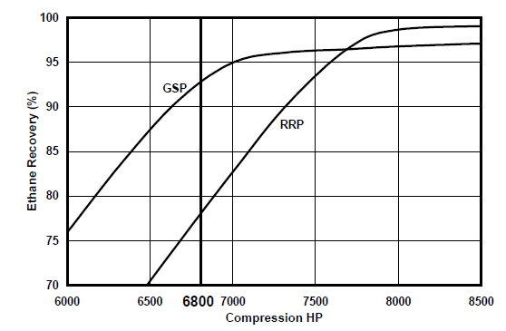
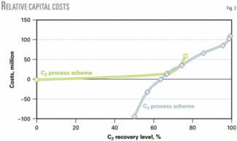
More Liquids Recovery Generally Requires More Energy
$2K/HP is a commonly used factor for capital cost. If the power is provided by natural gas, the operating cost directly tied to the cost of gas. If the compressors are electrically driven, the cost is directly tied to the cost of power: $0.08 to $0.28/kWh, or more.
As a result, costs increase as liquid recoveries increase.
https://www.ogj.com/articles/print/volume-103/issue-32/processing/study-identifies-optimal-csub2-sub-recovery-for-ngl-plants.html

Slide 31
Thank You
Michael Morgan
Director, Analytics
Phone: +1-403-266-9437 Fax: +1-403-262-1855
Email: mmorgan@gljpc.com
GLJ Petroleum Consultants Ltd. 4100, 400 - 3rd Ave. S.W. Calgary, Alberta, Canada T2P 4H2

Slide 32
Supplementary Data and Examples

Slide 33
How can we answer these questions?
What is the chance of realizing a 10%-discounted NPV greater than zero for an 8-well horizontal drilling program spread across the Kerrobert area Viking?
What if all 8 wells are drilled in the same section?
How likely is a single Kerrobert Viking well to have an IRR greater than zero?
How many Kerrobert Viking wells would need to be drilled to be 90% confident of a 10%-discounted PI greater than 1.2?
What if all wells are drilled within two miles of each other?
What is the chance that the WTI price will average at least $60/bbl in 2019?
What average 2019 WTI price are we 90% confident will be exceeded?

Slide 34
With probabilistic analysis!
Identify analogous wells
Run Monte Carlo simulation
Generate revenues
100,000 iterations
Build production forecasts
Confirm Monte Carlo results
Apply costs, royalties & other adjustments
Generate parameter distributions
Use a stochastic price forecast?
Yes
No
Calculate final cash flows
Create a correlation matrix
Use Ornstein-Uhlenbeck process
Use deterministic price forecast
Calculate performance metrics
Inform your decision

Slide 35
Which factors are “known”?
Components of a Half-Cycle Economic Analysis
Prices
Production & EUR
Capital Costs
Operating Costs
Royalties
Market prices are hard to predict
Normally predictable to ±70% with 95% confidence one year out
Hedging can improve certainty
Well performance
Operational issues
Economic factors can limit
Less Certain
Usually predictable within 15%
Uncertainty largely tied to success/failure and experimentation
Transportation bottlenecks
Line pressures
Unexpected issues, maintenance
Competition, partnerships
Long term uncertainty in regulatory framework
Short term is (usually) quite certain

Slide 36
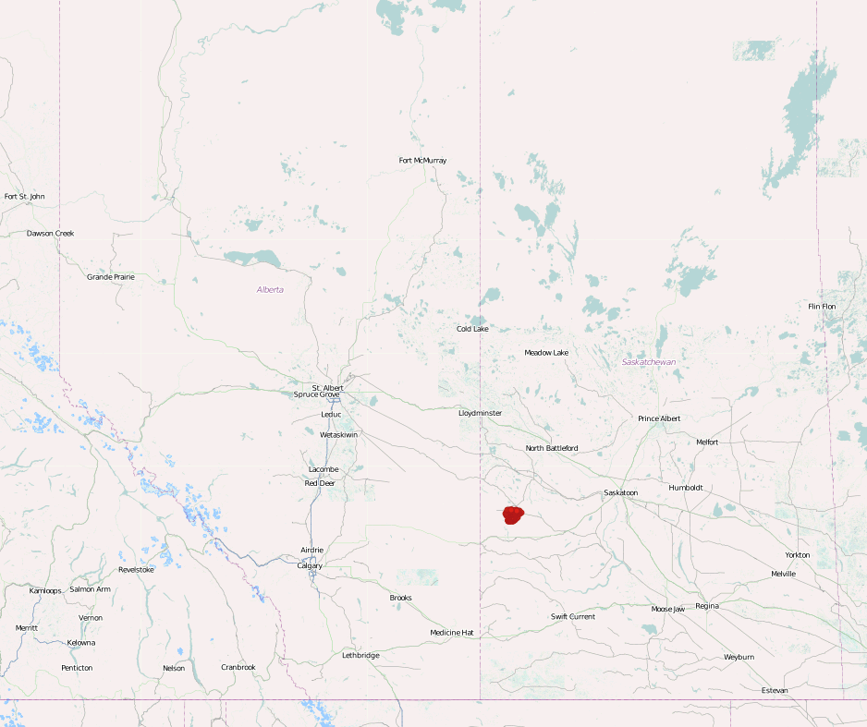
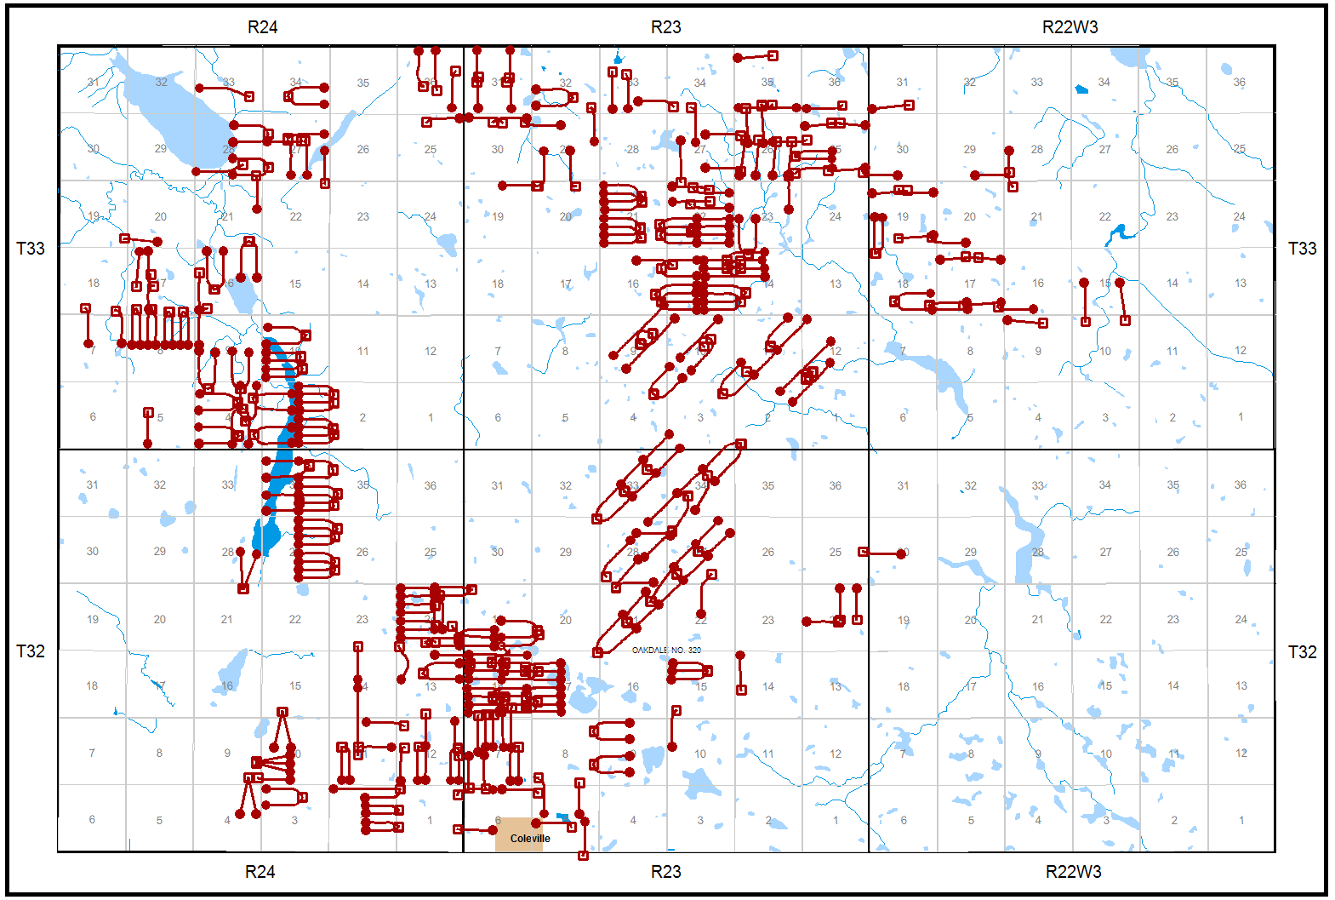
Sample Area – Kerrobert Viking
Choosing a sample area
Geologically similar
>30 wells is best
Representative of your area of interest

Slide 37
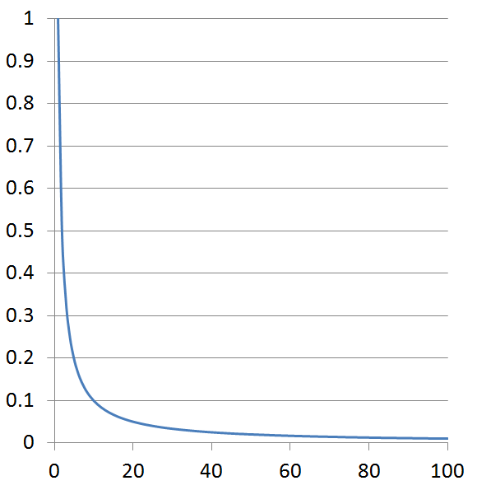
Most relationships in resource analysis are nonlinear
Spearman’s Rank Correlation vs. Pearson’s Correlation
Pearson’s Correlation
Assumes constant variance
Tests fit to straight line
Is the ‘R’ in the familiar ‘R²’
Pearson’s R = -0.48
Spearman’s R = -1.00
Spearman’s Rank Correlation
Is the linear correlation of ranks
Better for nonlinear relationships
Less sensitive to extreme outliers

Slide 38
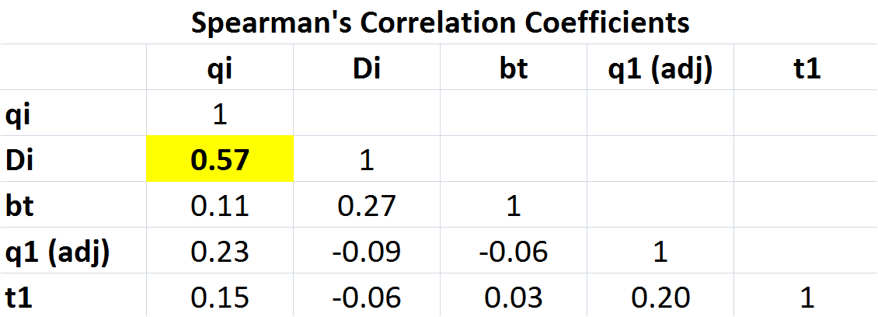
Decline parameters are not independent!
It is nearly always incorrect to move a type curve up or down proportionally to IP – the EUR to IP relationship is nonlinear

Slide 39
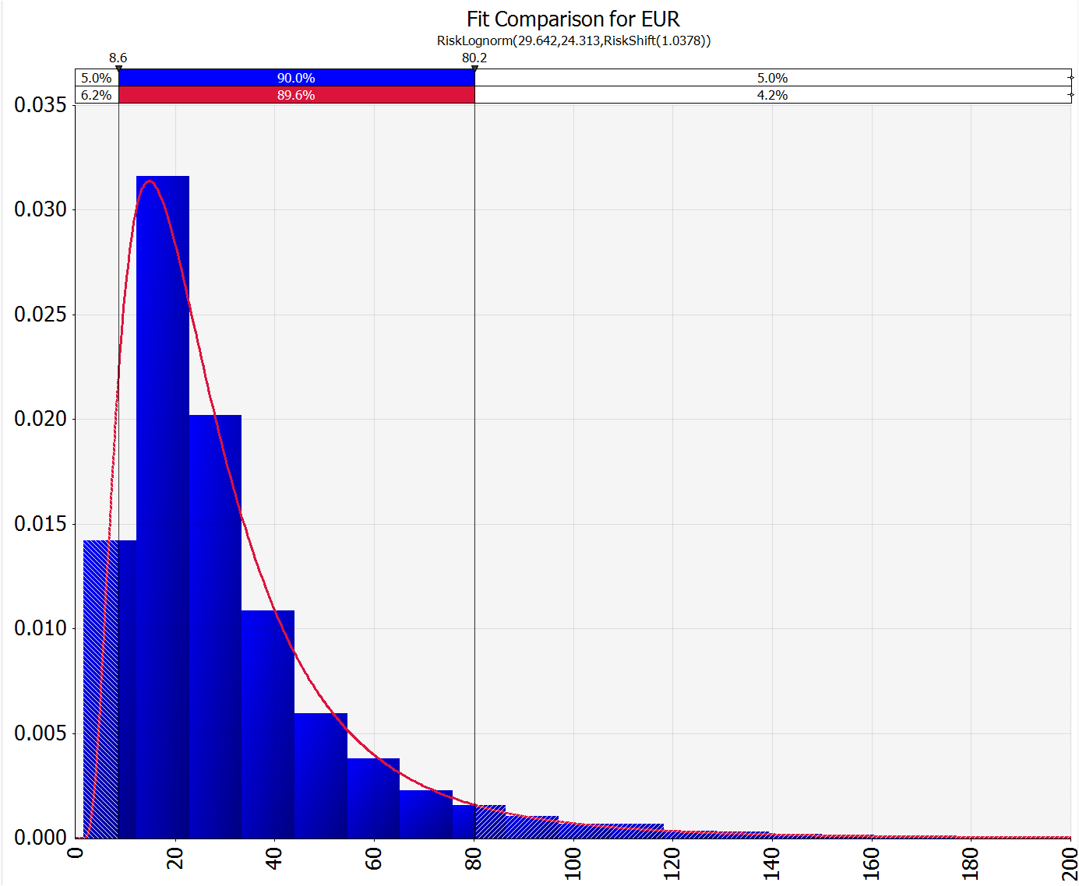
Distribution for a - Kerrobert Viking

Slide 40
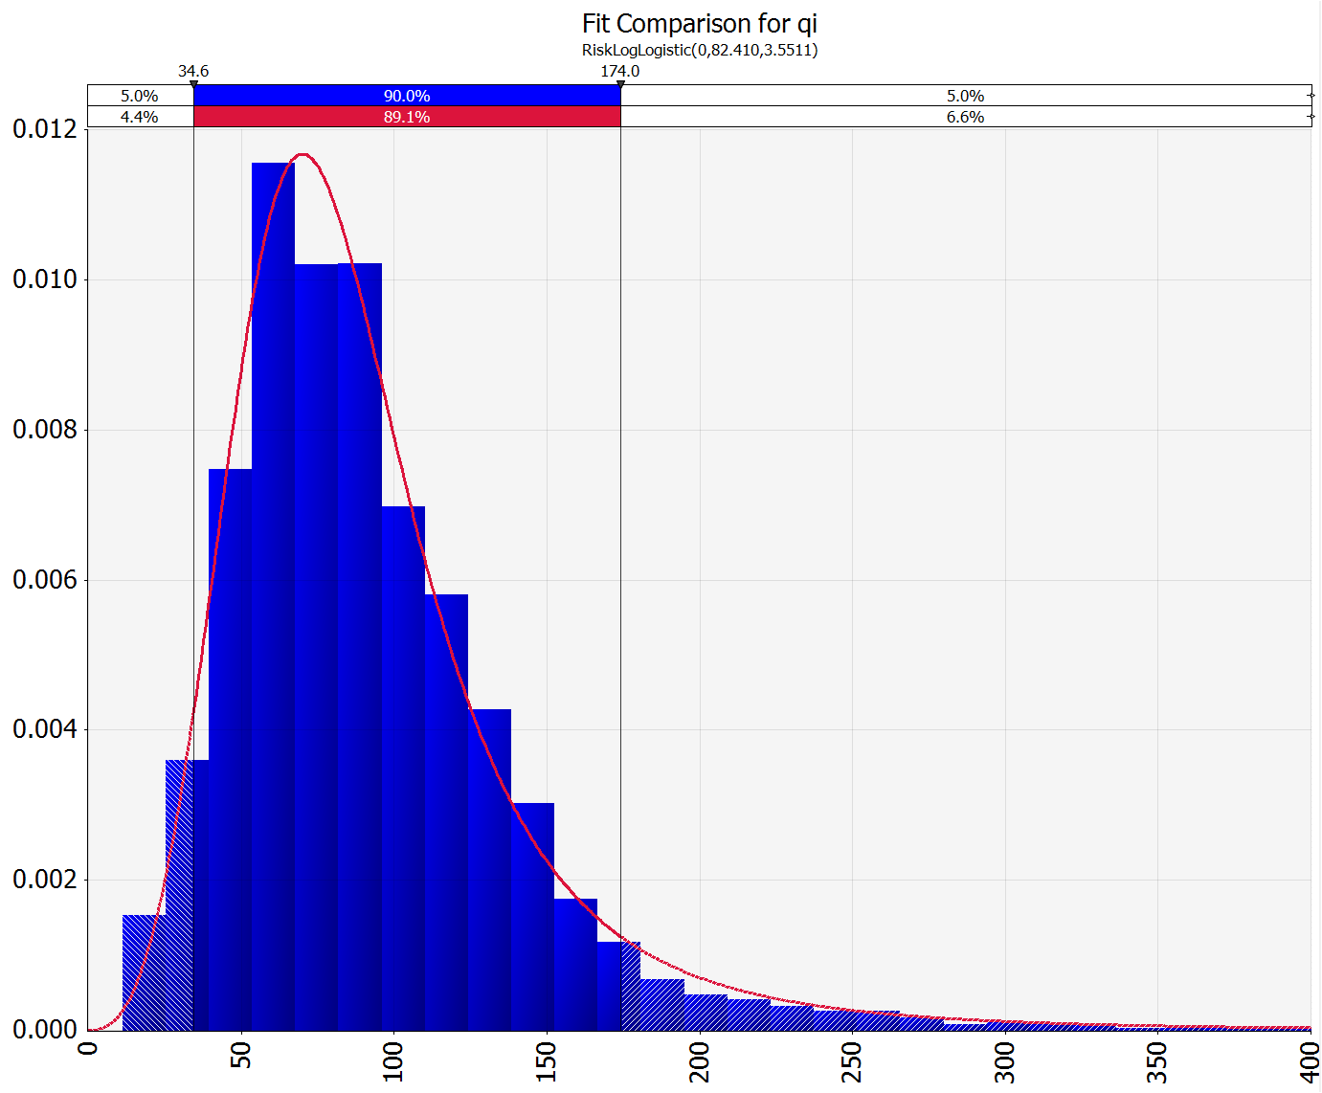
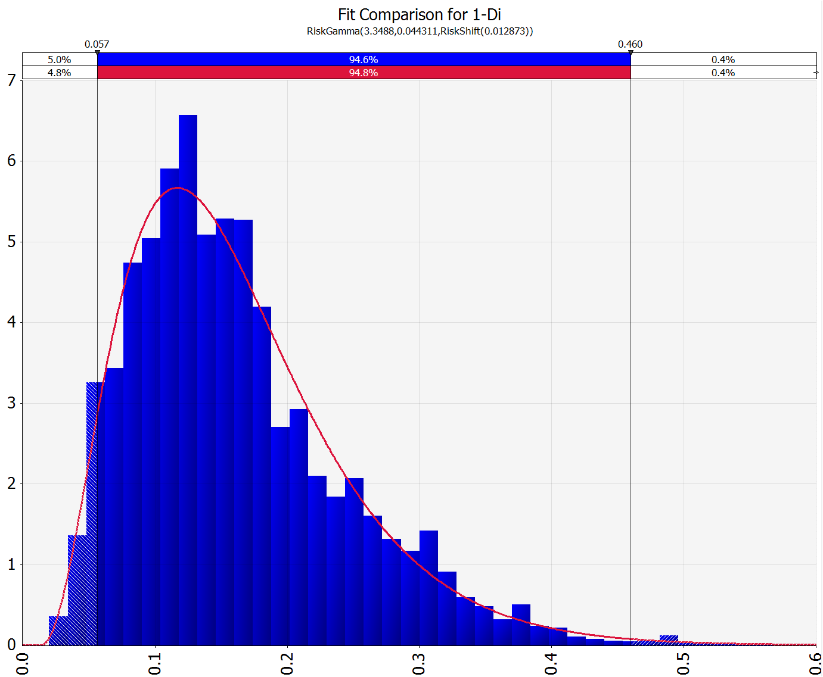
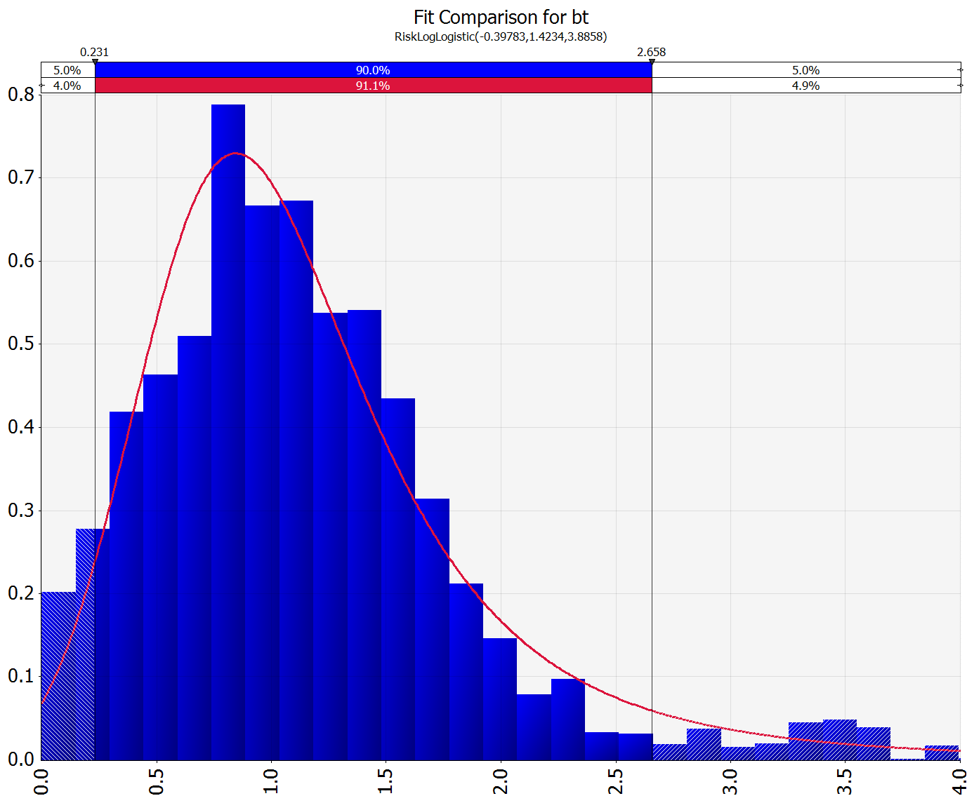
Sampling with dependence - Kerrobert Viking
100,000 times
Initial Rate
Initial Decline Rate
Transient Exponent
(1-Di)

Slide 41
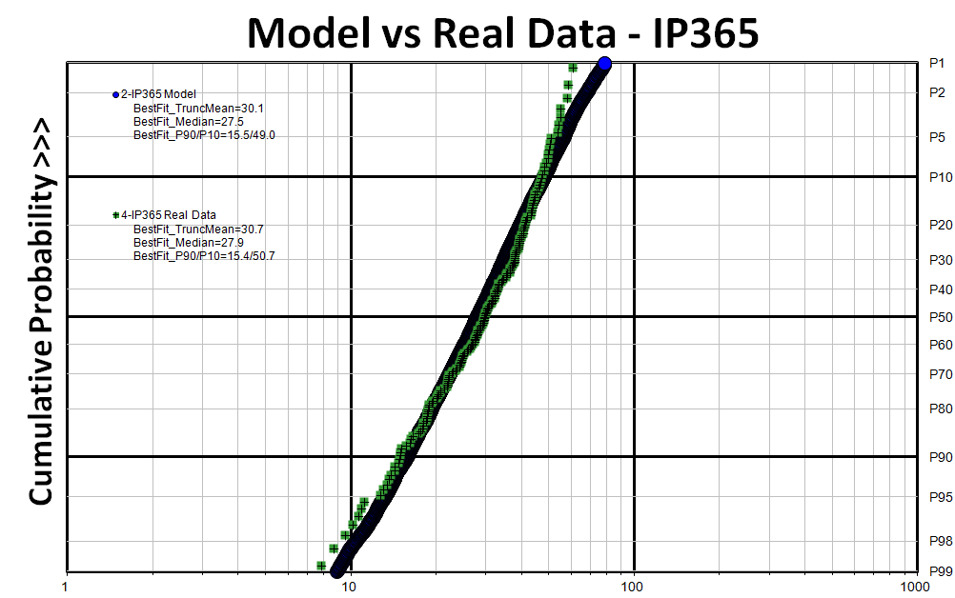
Confirming production forecast results
Real Data
MC Sim Results
Looks good –
P10/P90 ratios are within 4%

Slide 42
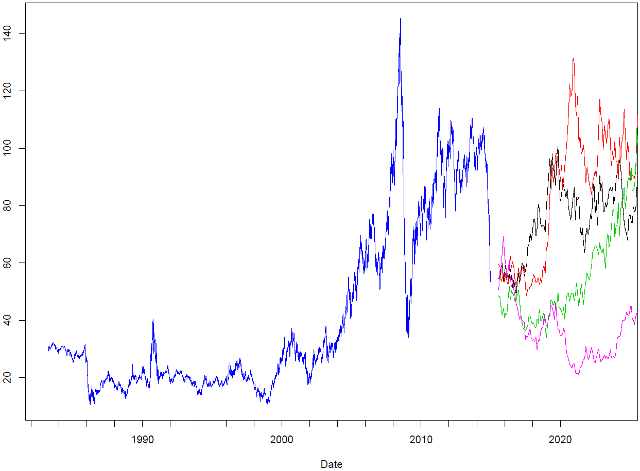
Calculating revenues with stochastic pricing
Each of the 100k production forecasts run with a stochastic price forecast anchored by common long-term forecasts ($75 WTI and $3.50 Henry Hub)
PF #1
Revenue #1
PF #2
Revenue #2
PF #3
Revenue #3

Slide 43
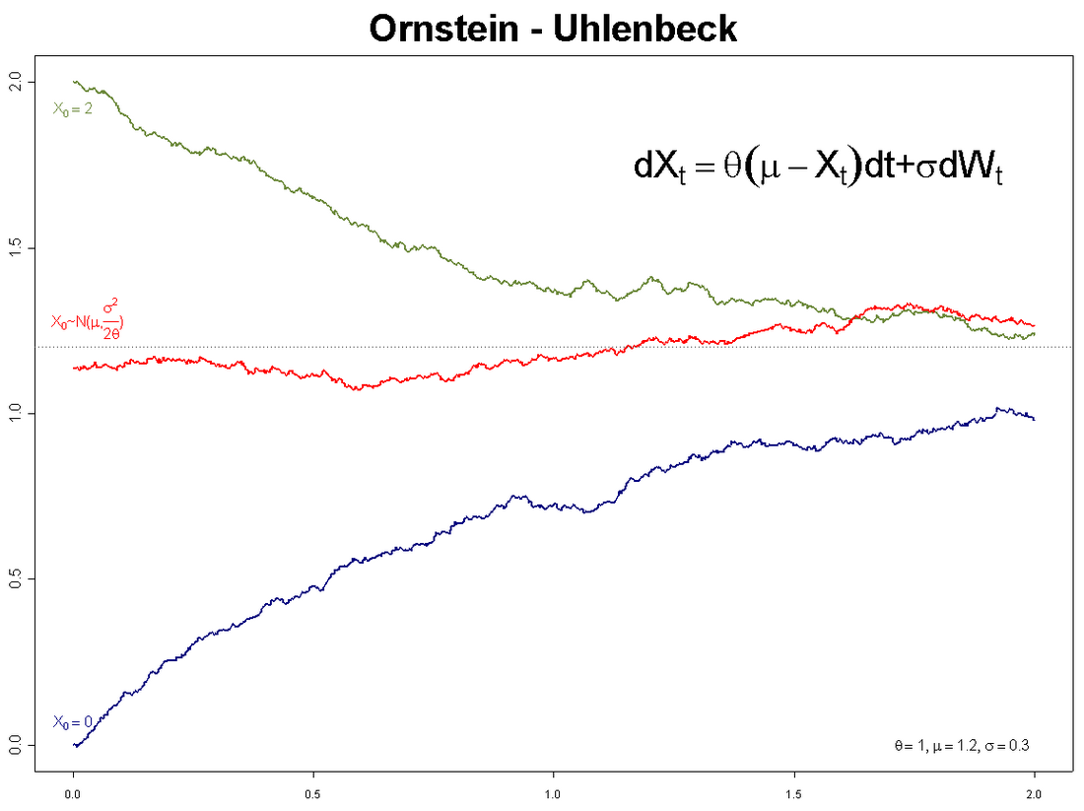
Stochastic price forecast: the Ornstein-Uhlenbeck process
A modified random walk with a mean reversion tendency
Has four parameters:
Xo: initial price
µ: equilibrium price
σ: volatility
θ: rate of shock dissipation
Source: Wikipedia

Slide 44
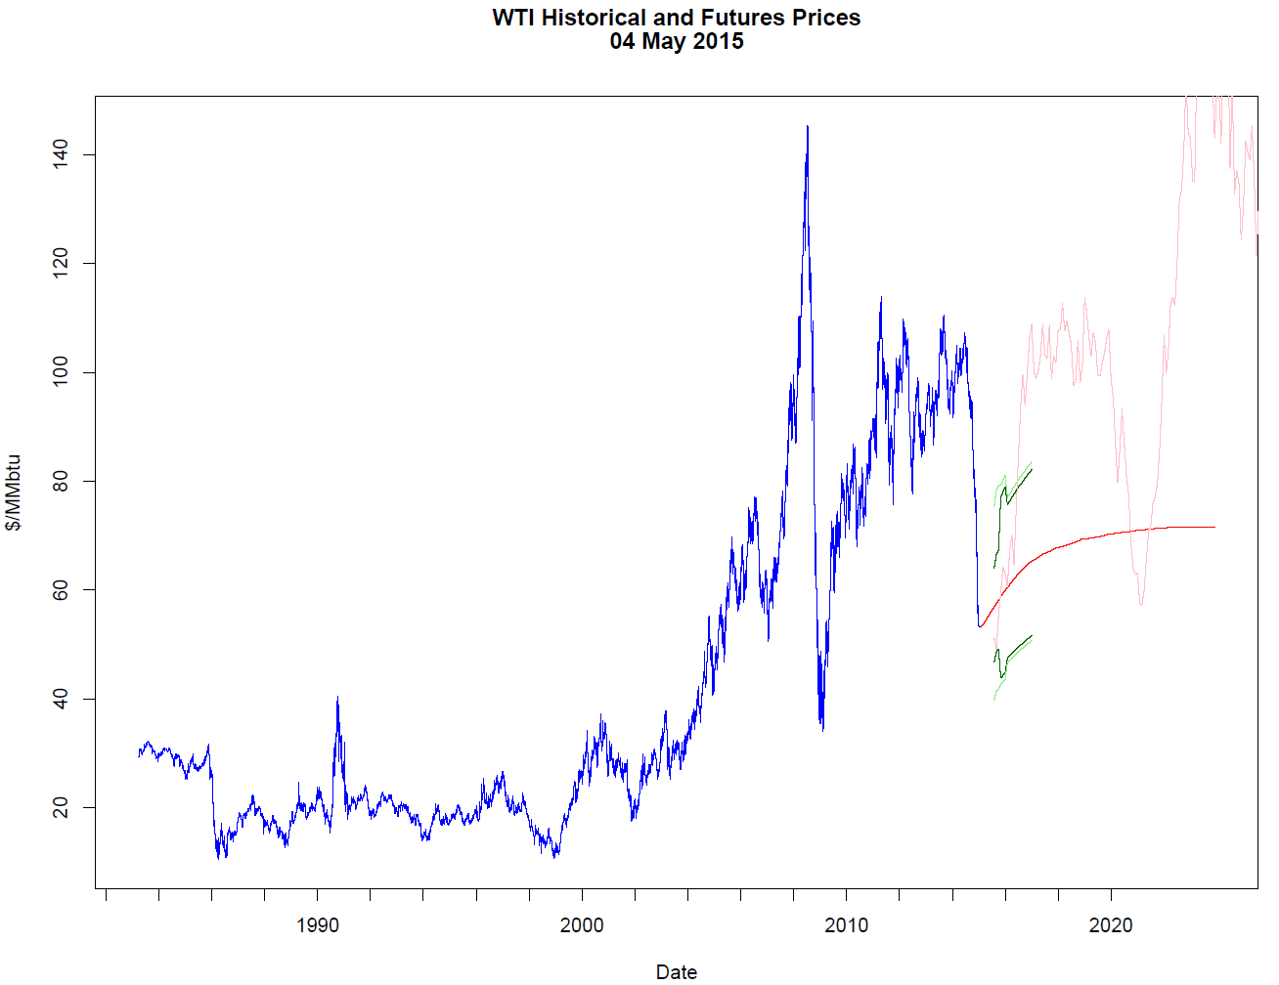
Choosing suitable parameters for the O-U process
Rate of shock dissipation: 5 years (based on historical data, detailed in SPE-162629 paper)
Equilibrium Price: $75
USD/bbl
Volatility
Initial price: $48
Date

Slide 45
WTI – 68% confidence that price will be between $32/bbl and $75/bbl through 2016
Implied volatility can be calculated from the prices of options sold by banks
68% confidence

Slide 46
Henry Hub – 68% confidence that price will be between $2.05/MMBtu and $5.25/MMBtu through 2016
68% confidence

Slide 47
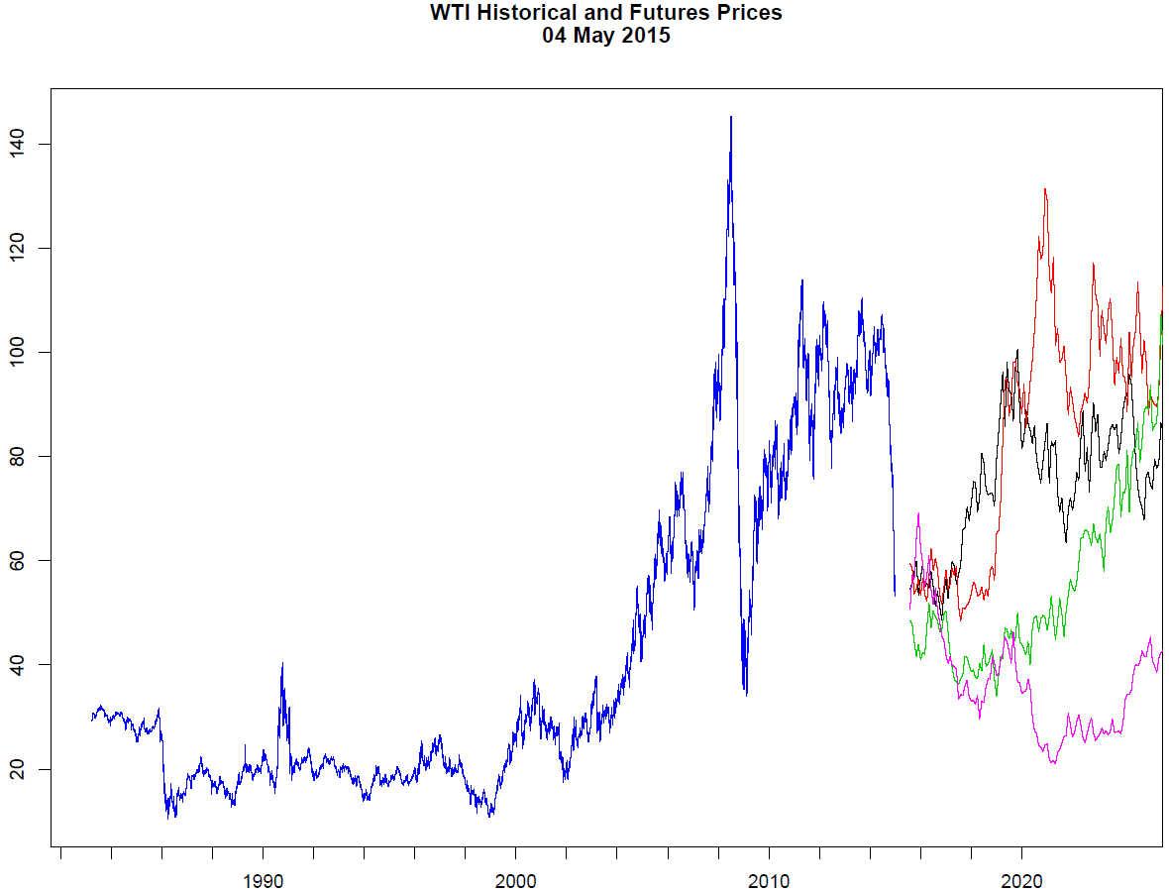
Possible Future WTI Price Realizations
Possible future price realizations
O-U equilibrium prices:
WTI: $75/bbl
HH: $3.50/MMBtu
USD/bbl
Date

Slide 48

From revenues to cash flows
Capital Costs
Operating Costs
$600k-$850k
GLJ Database + Probabilistic Sampling
Price Adjustments
Byproduct Yields
Surface Loss

Slide 49
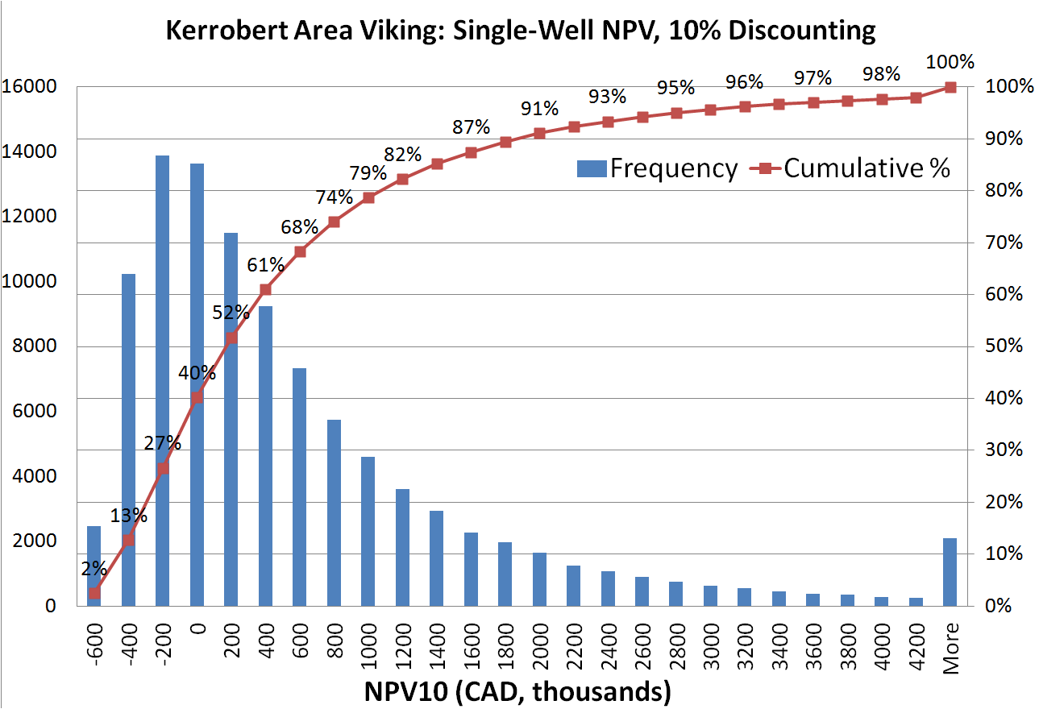
Single-well net present value, 10% discounting
Mean: $537k
P90: -$445k
P50: $168k
P10: $1866k

Slide 50
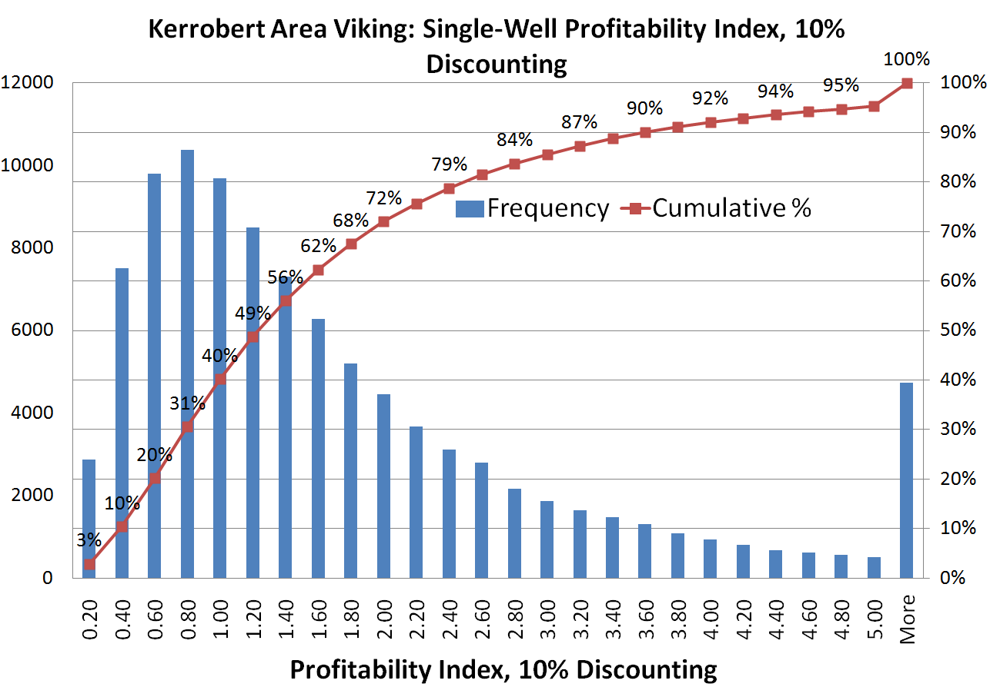
Single-well profitability index, 10% discounting
Mean: 1.75
P90: 0.39
P50: 1.23
P10: 3.59

Slide 51
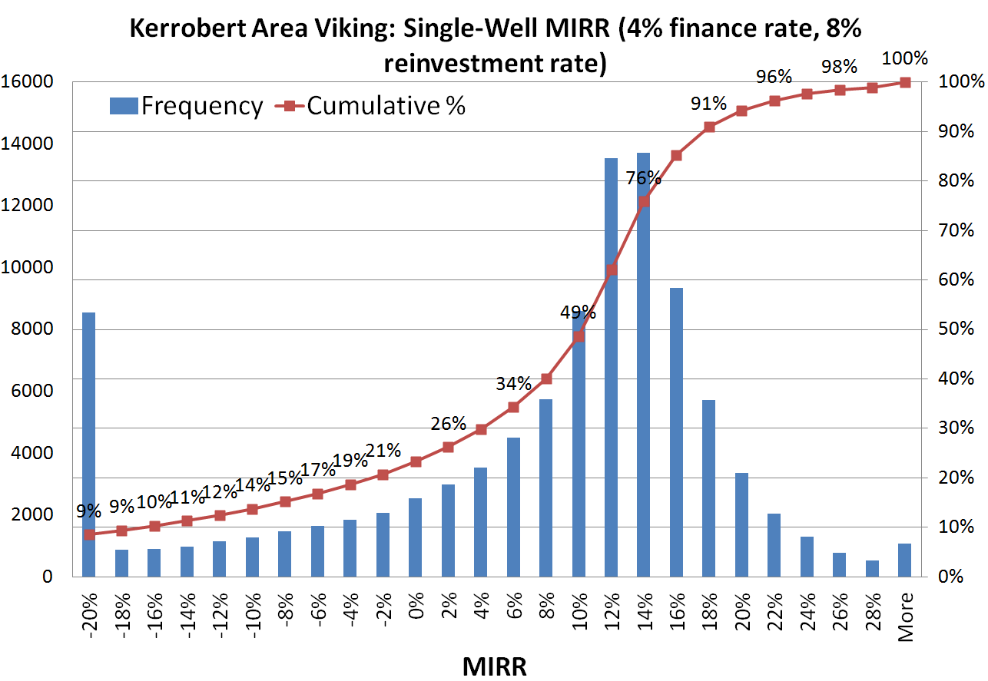
Single-well modified internal rate of return
Mean: 4.5%
P90: -16.8%
P50: 10.2%
P10: 17.6%

Slide 52
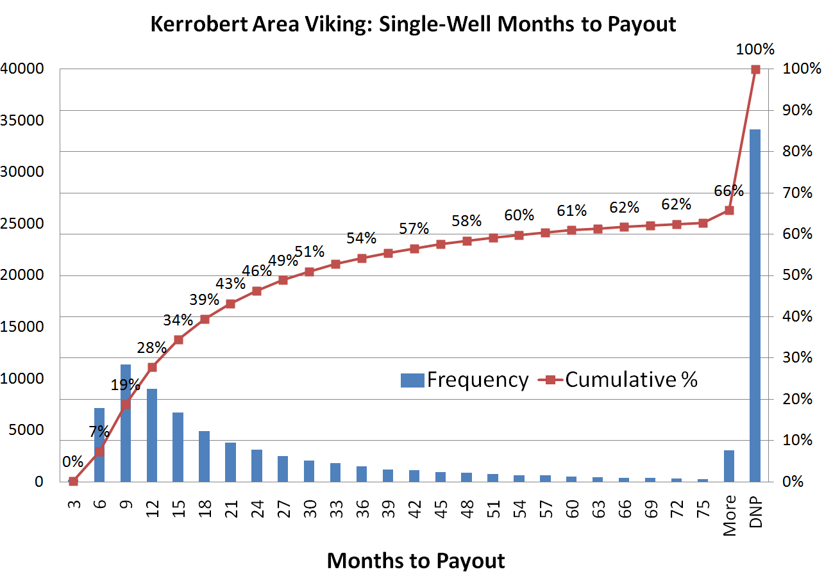
Single-well time to payout
P90: DNPO
P50: 29 mo
P10: 7 mo
34% never pay out

Slide 53
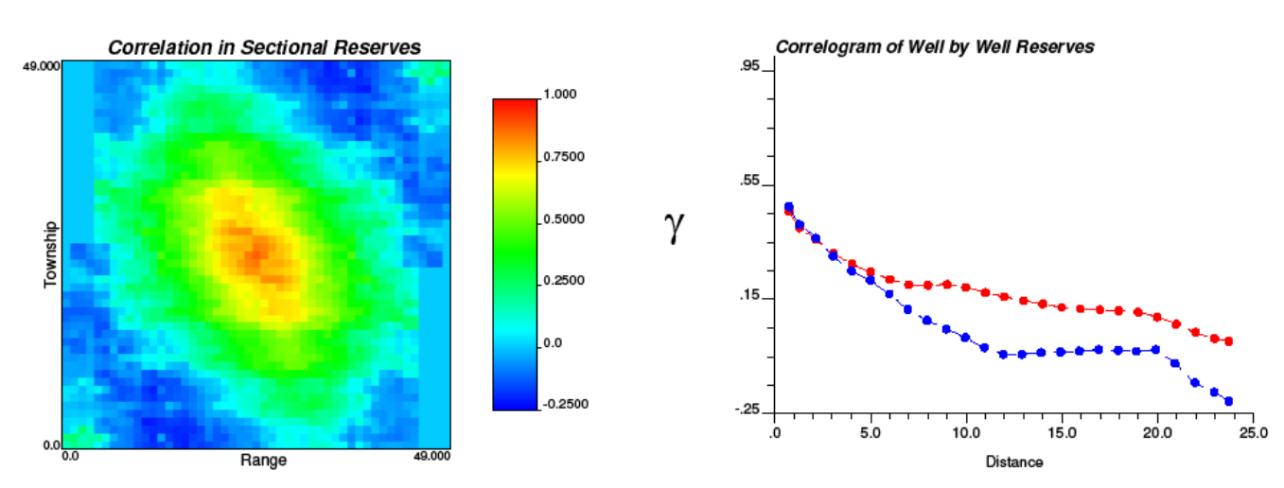
What if all wells are drilled in one small area?
Medicine Hat/Milk River Shallow Gas Example
Wells drilled nearer to each other are likely to perform more similarly than wells drilled further apart

Slide 54
Answers
What is the chance of realizing a 10%-discounted NPV greater than zero for an 8-well horizontal Viking drilling program spread across the Kerrobert area? 93%
What if all 8 wells are drilled in the same section? 87%
How likely is a single Kerrobert Viking well to have an IRR greater than zero? 66%
How many Kerrobert Viking wells would need to be drilled to be 90% confident of a 10%-discounted PI greater than 1.2? 17
What if all wells are drilled within two miles of each other? 19
What is the chance that the WTI price will average at least $60/bbl in 2016? 12%
What average 2016 WTI price are we 90% confident will be exceeded? $38/bbl
Based on October 6, 2015 market data

Slide 55
What to Expect
Inflation matters, as does your choice of inflation adjustment.
Extreme prices don’t last long.
US prices are not the same as Canadian prices.
Each hydrocarbon and sales point has its own set of price statistics. Simple offsets or ratios to benchmark prices capture only a portion of this price behaviour.
For brevity, this presentation concentrates on the most widely quoted prices (WTI and HH).
Real prices are normalized to Dec 31, 2010
US $ are in blue, Canadian $ are in red

Slide 56
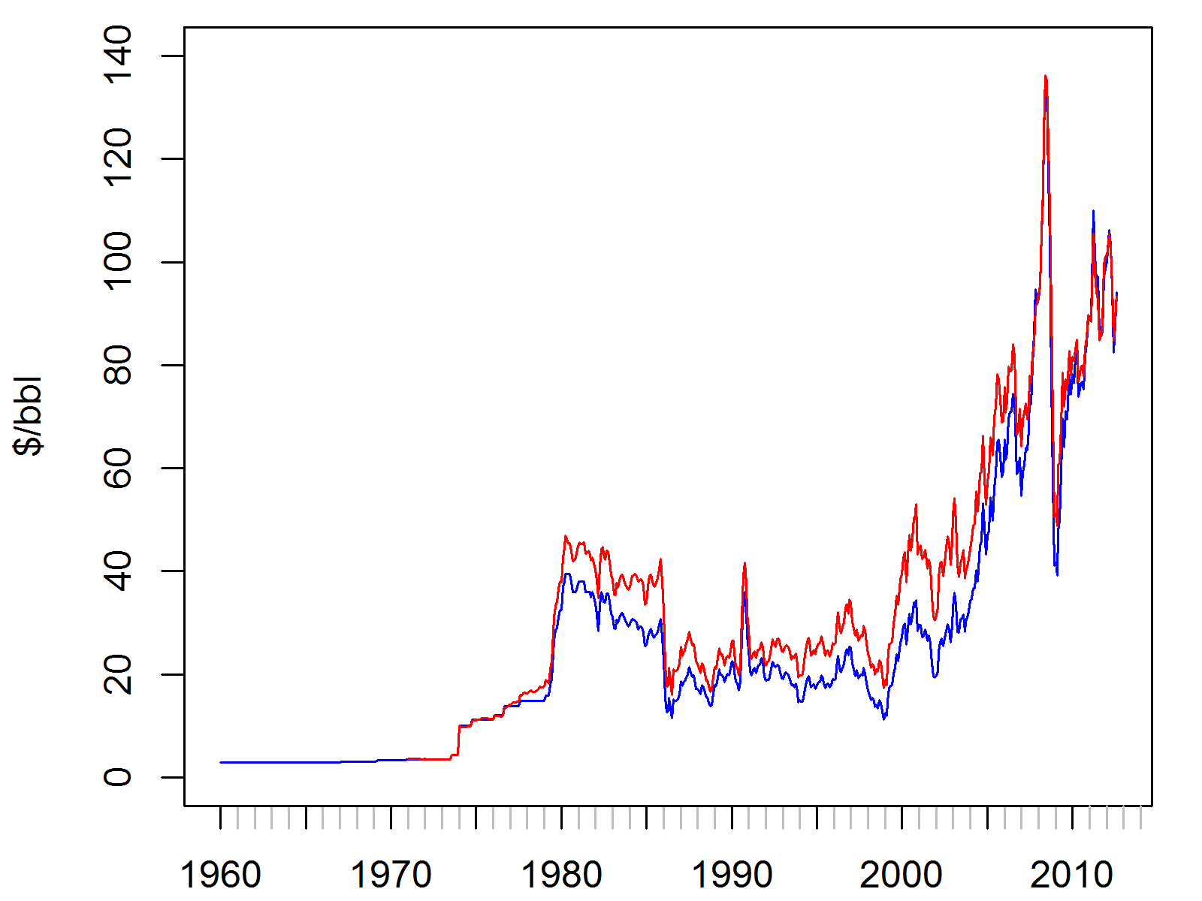
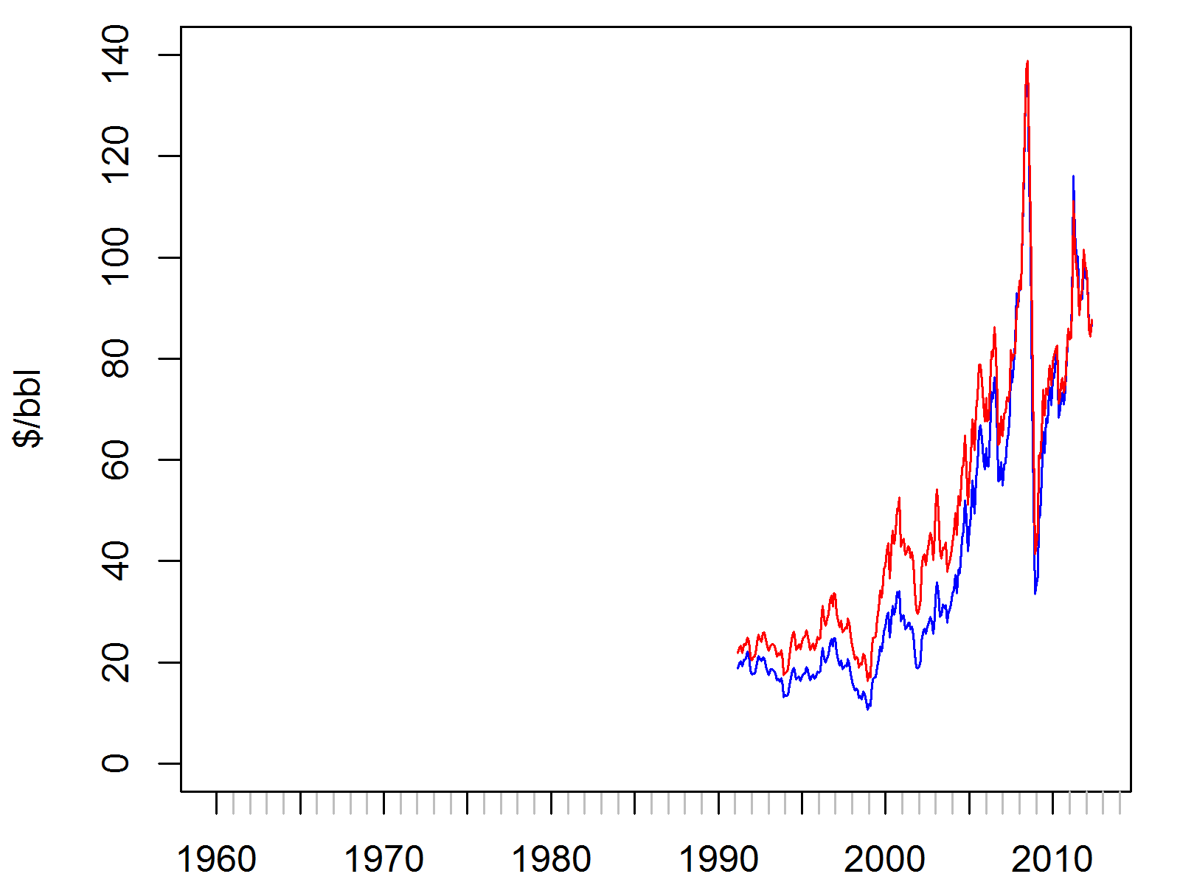
Nominal Oil Prices
WTI Oil Prices
$US/bbl (blue) and $CDN/bbl (red)
Edmonton Light Oil Prices
$US/bbl (blue) and $CDN/bbl (red)
Madonna
VIP Tickets
No surprise here… sometimes sticker prices are different and sometimes the offsets are larger.
You might think oil gets less affordable over time.

Slide 57
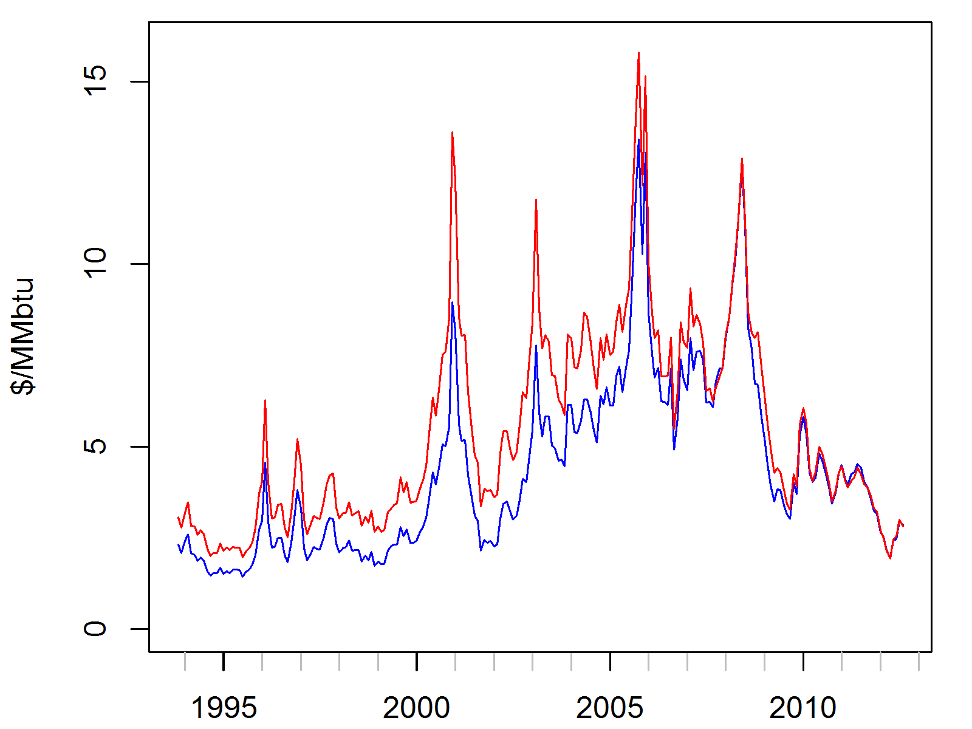
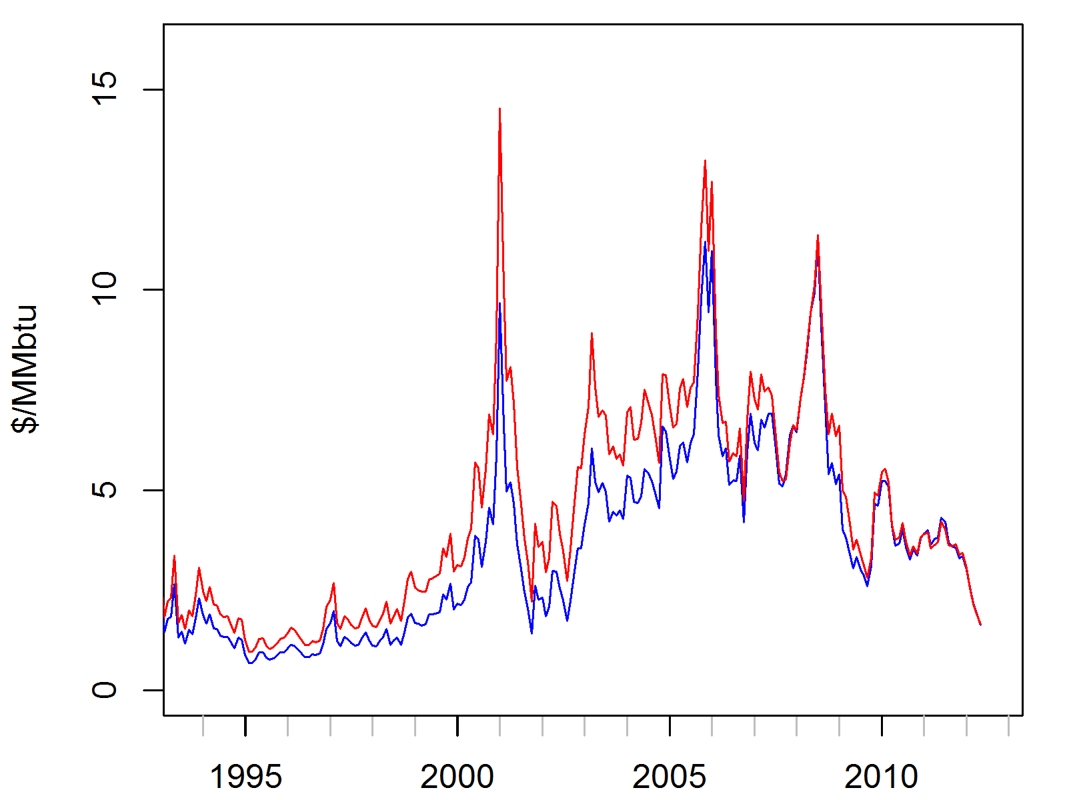
Nominal Gas Prices
Henry Hub Gas Prices
$US/MMbtu (blue) and $CDN/MMbtu (red)
AECO Gas Prices
$US/MMbtu (blue) and $CDN/MMbtu (red)
Deal of the Decade!
Again, no surprise… basis differentials can change

Slide 58
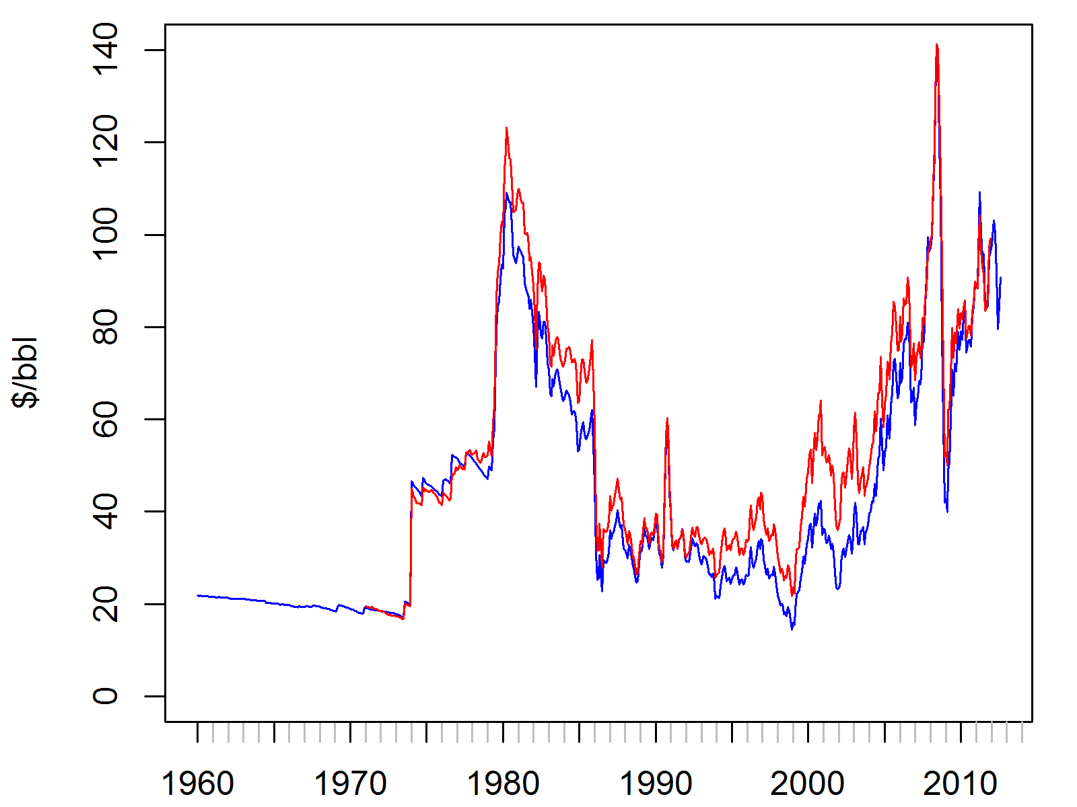
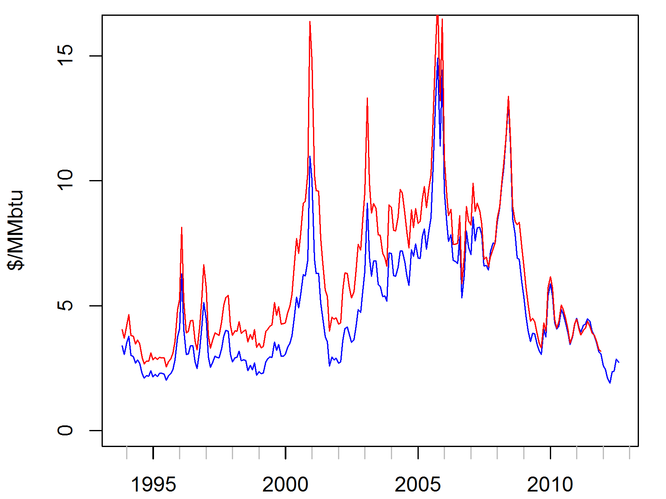
Real Prices (CPI or Consumer Prices)
WTI Oil Prices
$US/bbl (blue) and $CDN/bbl (red)
Henry Hub Gas Prices
$US/MMbtu (blue) and $CDN/MMbtu (red)
Friday Ticket Prices
I guess everything did cost less back then.
By this measure, oil is as affordable as in 1982.

Slide 59
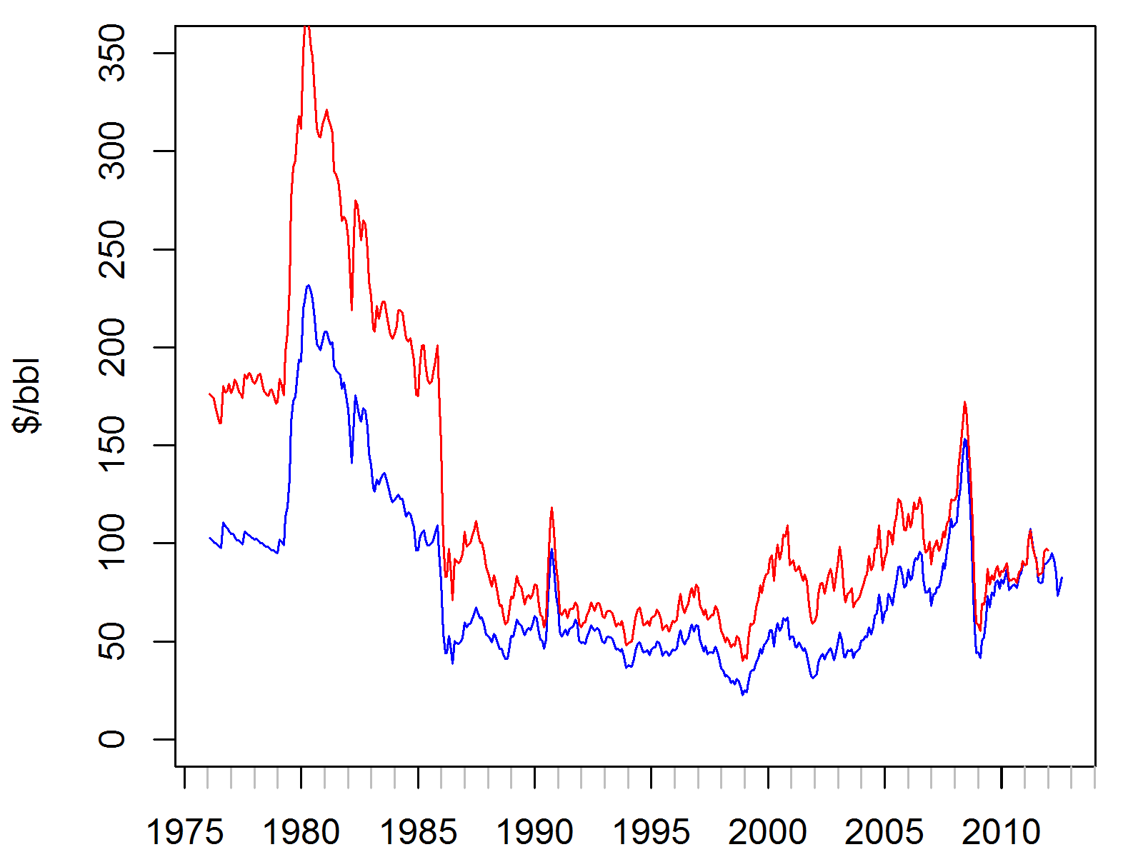
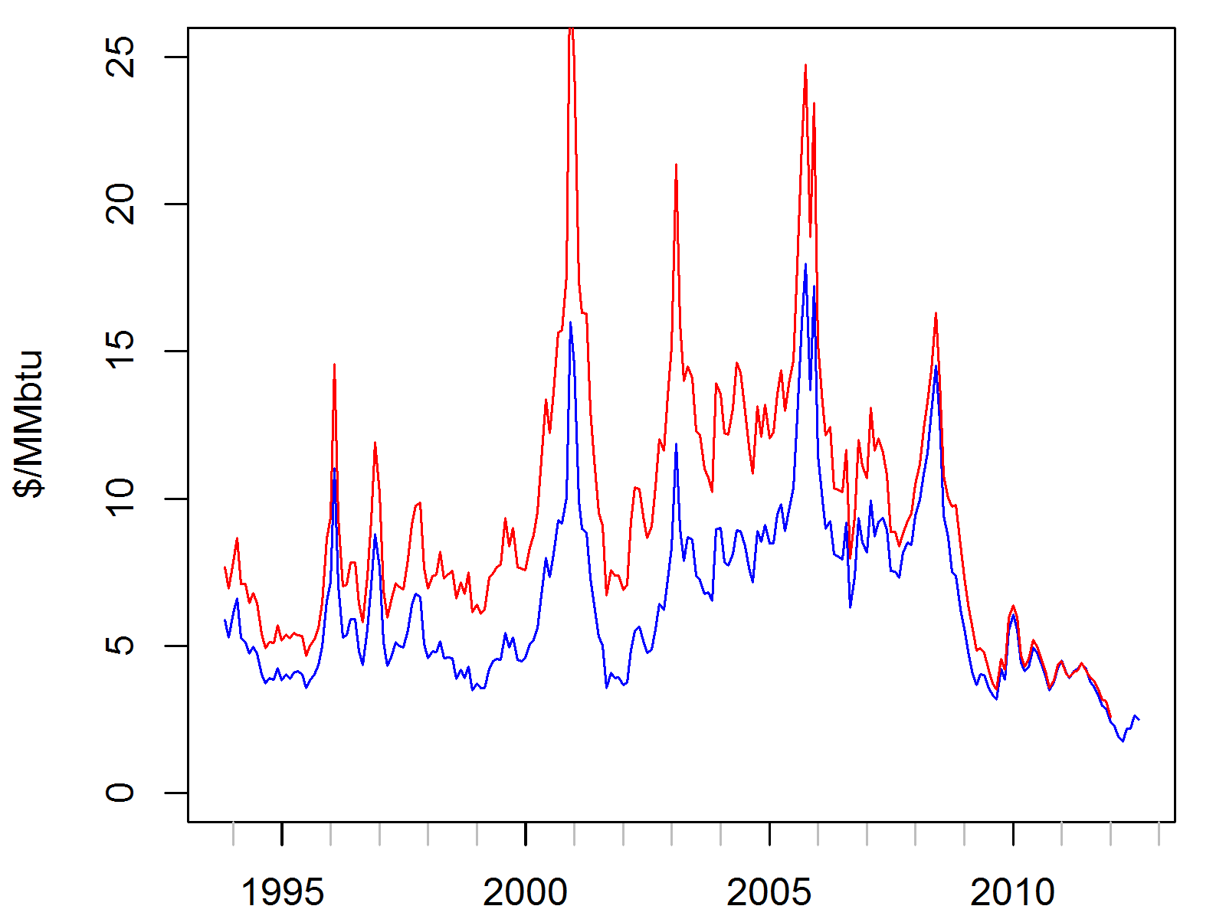
Real Prices (M2 or Supply of Money)
WTI Oil Prices
$US/bbl (blue) and $CDN/bbl (red)
Henry Hub Gas Prices
$US/MMbtu (blue) and $CDN/MMbtu (red)
Wednesday Ticket Prices
Our Lowest Prices Ever!
If you believe that “inflation is always and everywhere a monetary phenomenon”…
…oil is as affordable as in 1985.

Slide 60
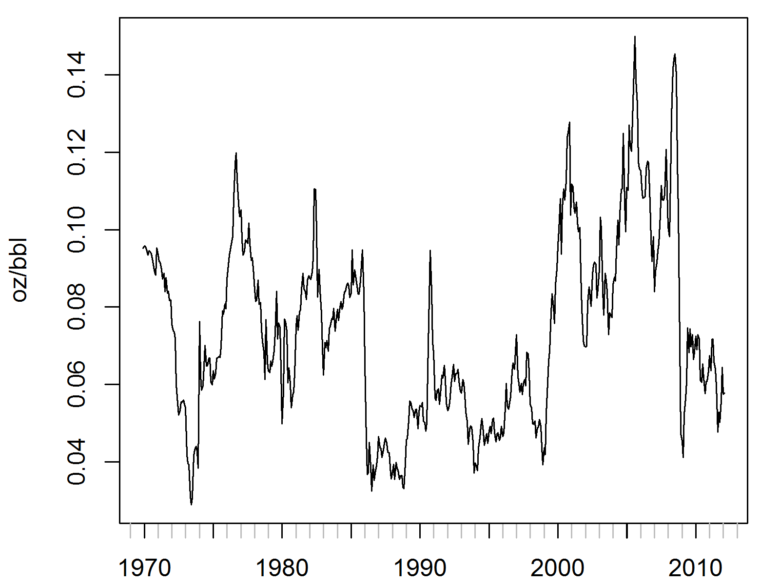
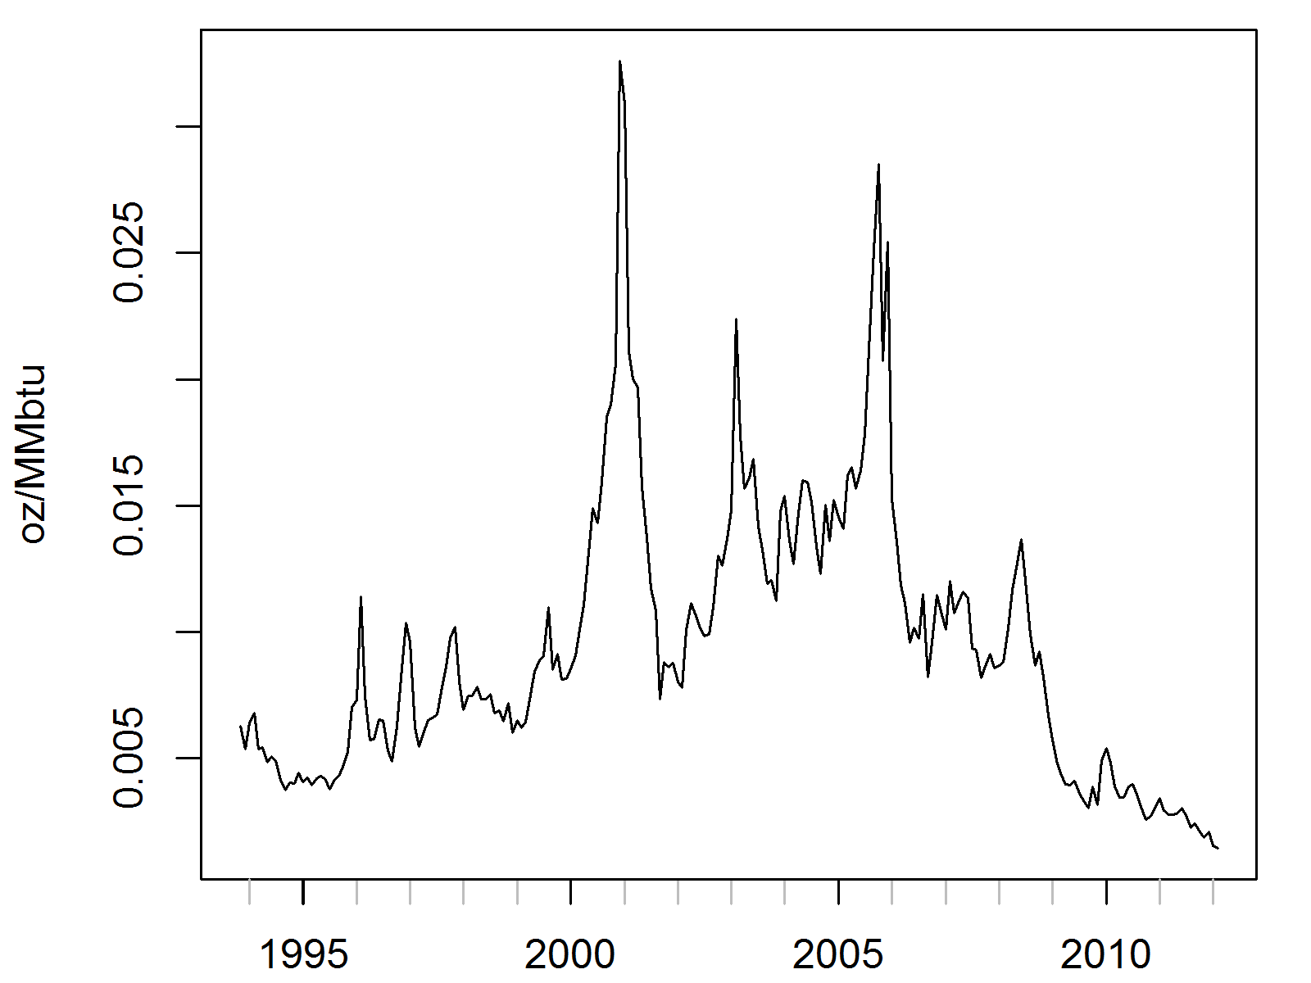
Real Prices (In Terms of Gold Price)
WTI Oil Prices
oz/bbl
Henry Hub Gas Prices
oz/MMbtu
If you believe that “Gold was an objective value, an equivalent of wealth produced. Paper is a mortgage on wealth that does not exist”… oil is cheap

Slide 61
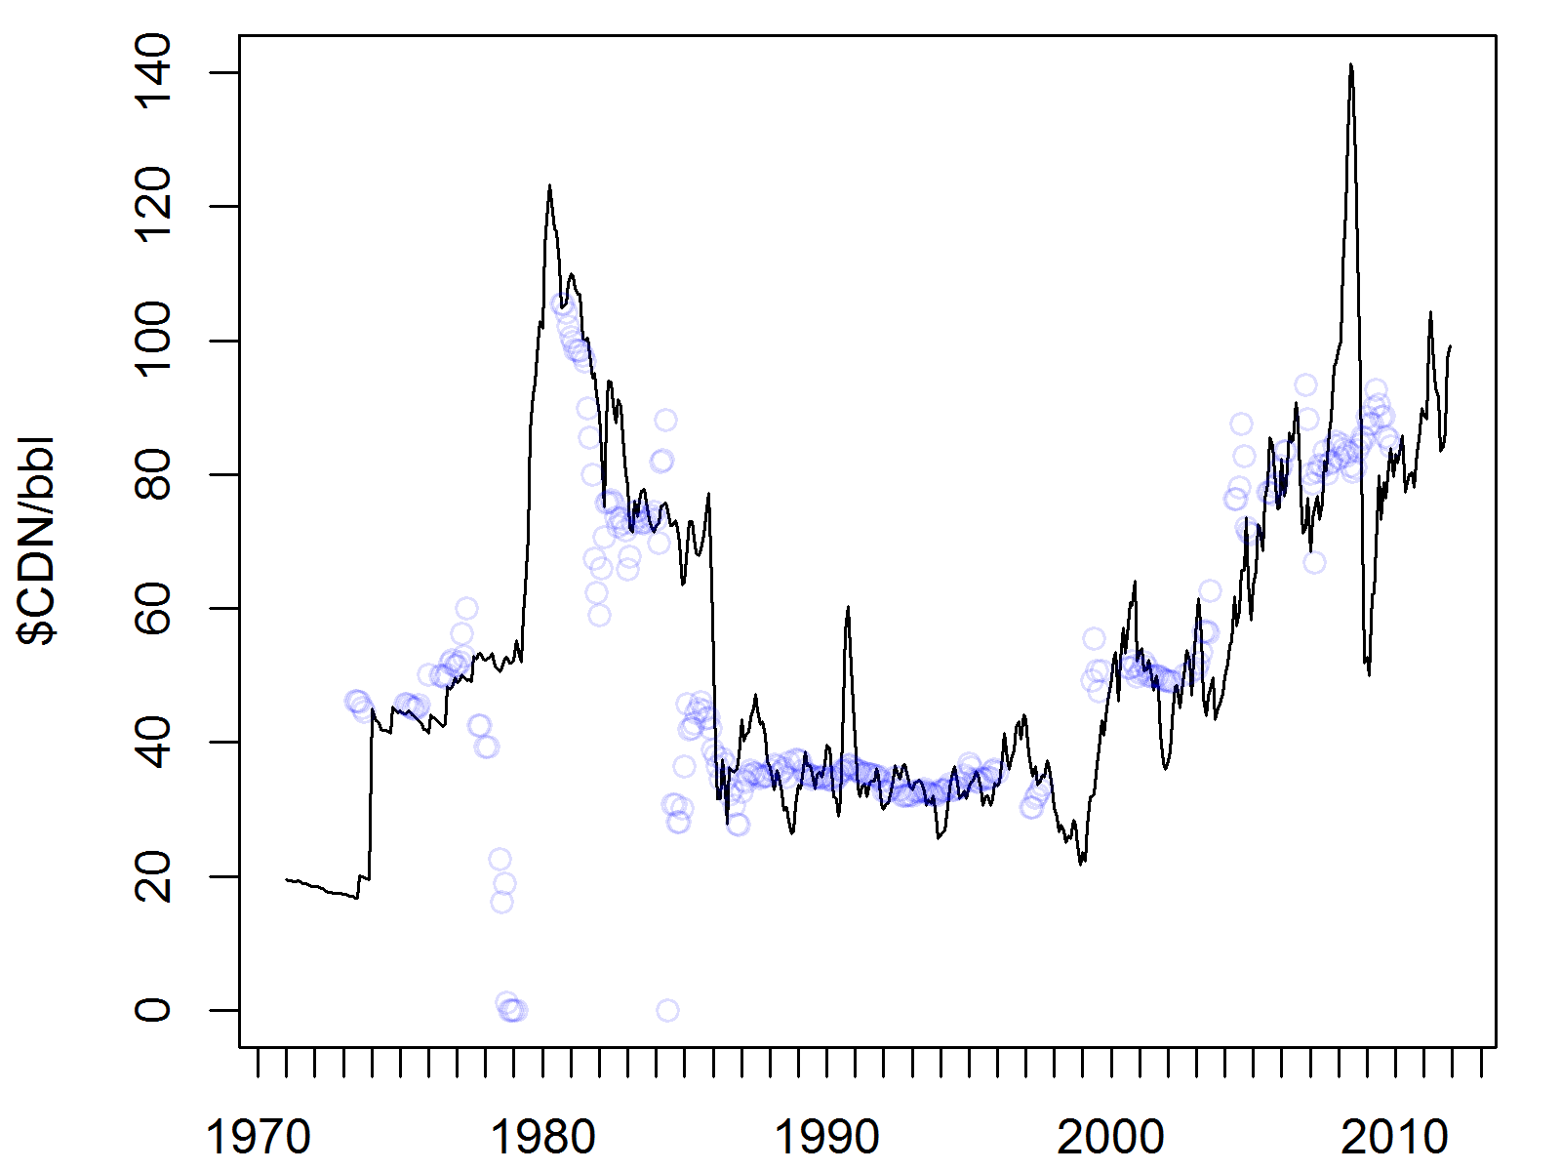
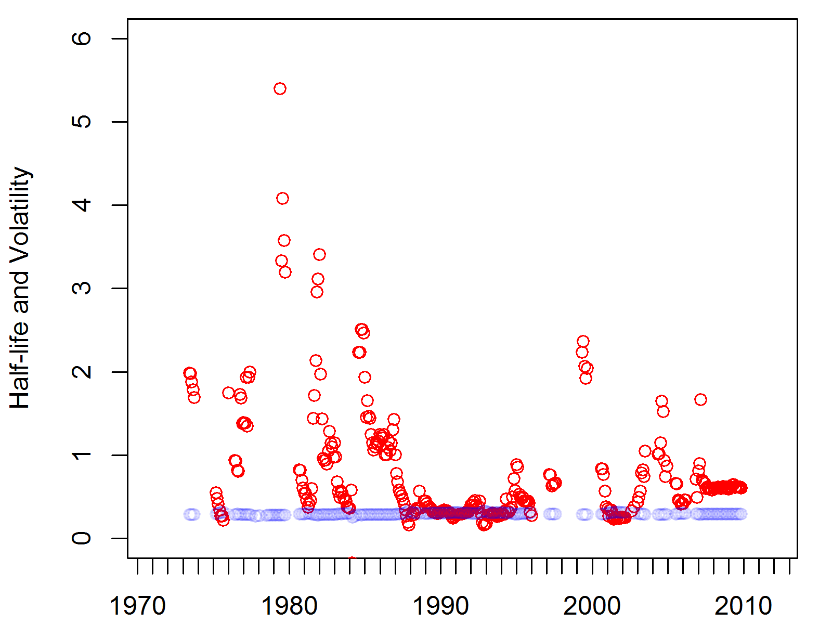
Real Prices (CPI or Consumer Prices)
WTI Oil Prices (Actual and μ)
$CDN/bbl
Half-life (years)
Volatility (%)
Using 4 year windows, the model gives estimated mean reversion prices (μ) that look like moving averages, constant volatilities and unstable half-lives.

Slide 62
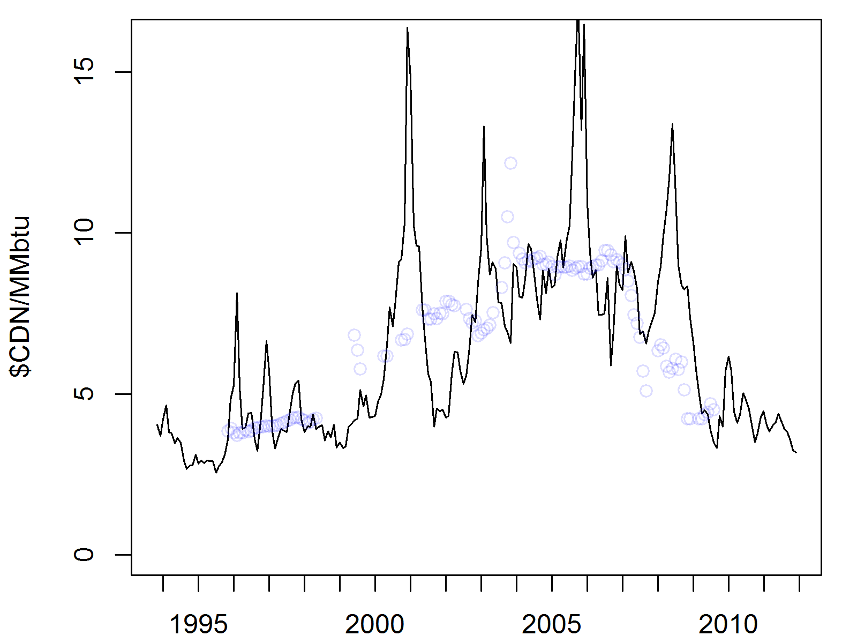
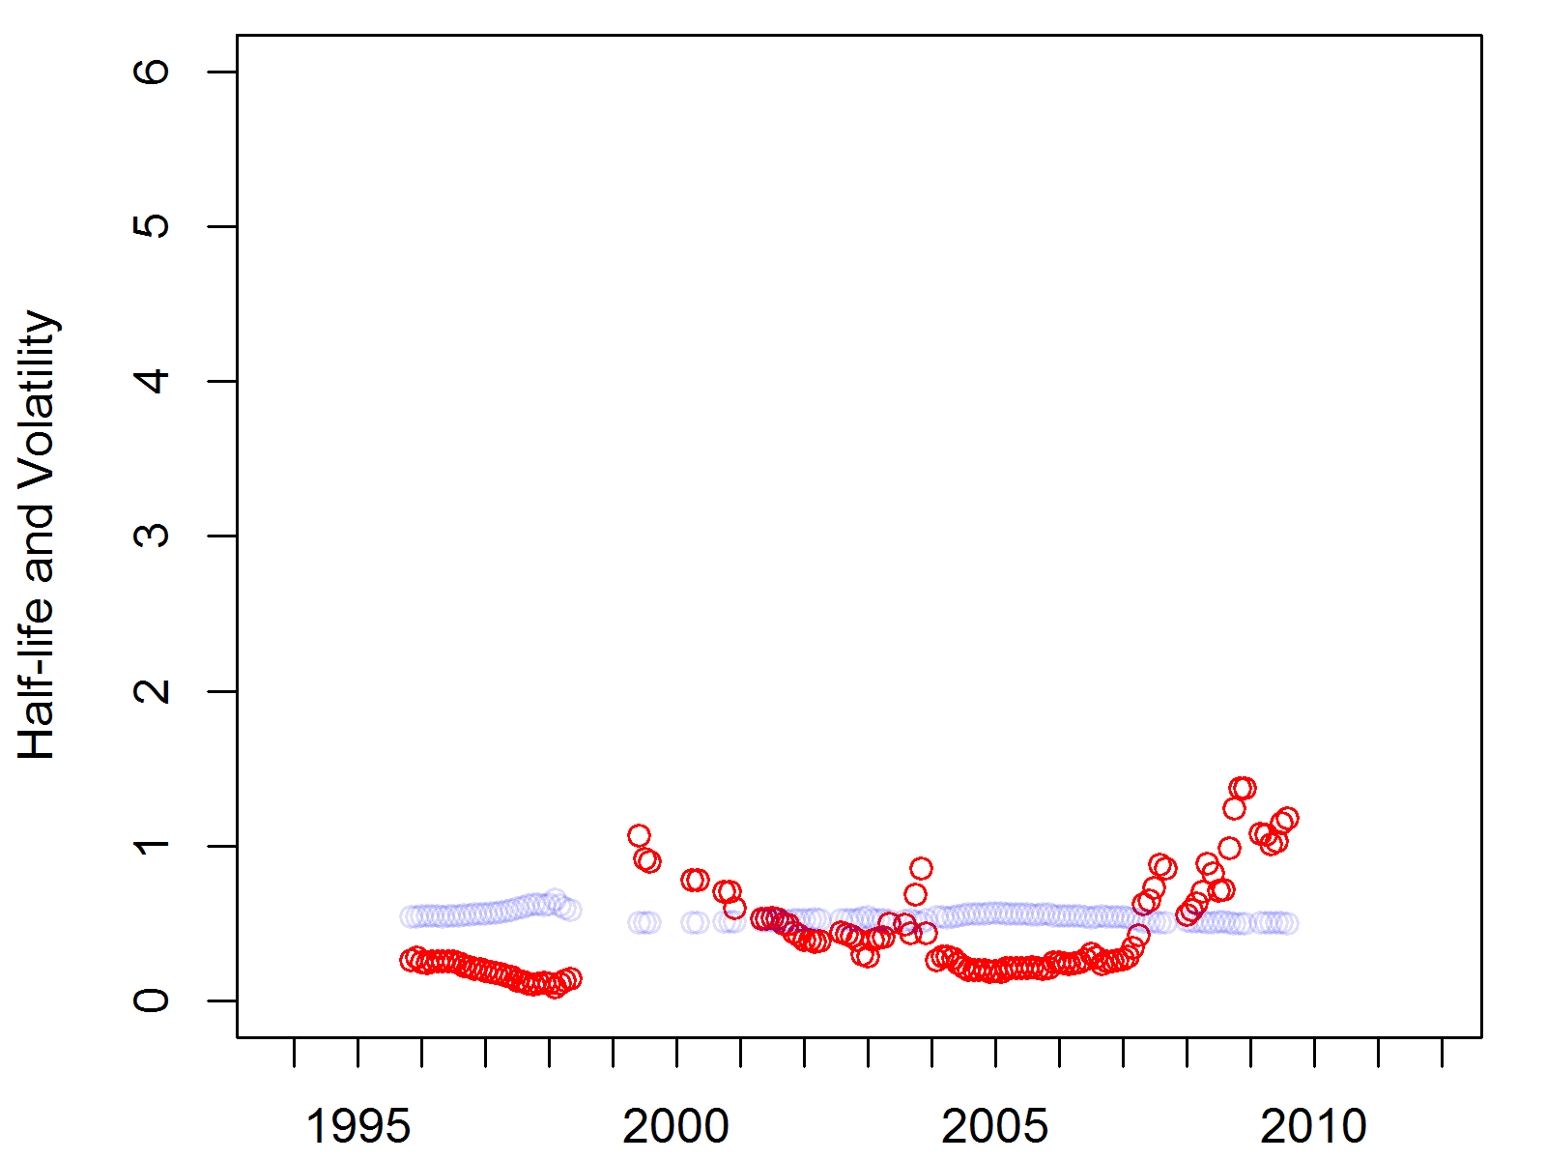
Real Prices (CPI or Consumer Prices)
Henry Hub Gas Prices (Actual and μ)
$CDN/MMbtu
Half-life (years)
Volatility (%)
Using 4 year windows, the model gives estimated mean reversion prices (μ) that look like moving averages, constant volatilities and unstable half-lives.

Slide 63
Obvious Conclusions
Prices for Canadian producers are related, but not the same as prices for US producers.
Discussing the price of a commodity in terms of only one currency ignores changes in the relative value between currencies and basis differentials.
Prices generally increase over time, but gas prices are currently very very low.

Slide 64
Not-So Obvious Conclusions
Short-term prices are unpredictable, but mean reversion should be included in any long-term model.
Any discussion of oil and gas prices must consider inflation, though you can pick from several measures of inflation. Some measures show that current oil prices are slightly high others show that prices are slightly low.
Real price changes of ±40% are common, but real prices generally edge back to average within 5 years.
Our paper lists fitted model coefficients for a number of benchmark Canadian hydrocarbons.

Slide 65
Prices have gone up, and they have gone down at times, but the predominant driver of higher prices appears to be general inflation.
The authors would also argue “increased scarcity causes the development of its own remedy”.
Prices, at least in real terms, are not forced to increase without limit due to scarcity of any single resource.
So long as the investment horizon is a couple decades or less, the data demonstrates that you must consider prices to be volatile but stationary.

Slide 66
SPE-162629 (Price Analysis up to 2012)
 |  | All Data up to 2012
 |  | µ | σ
WTI Brent Edmonton Light Sweet Henry Hub AECO Station 2 |  | 59.77 87.05 66.46 5.55 3.70 4.96 | 28.33% 27.96% 28.92% 50.37% 55.33% 64.22%
These prices aren’t unusual by long-term historical standards
“It is more clear than ever that short-term prices are unpredictable, but this paper will attempt to demonstrate once more that mean reversion should be included in any long-term model.”

Slide 67
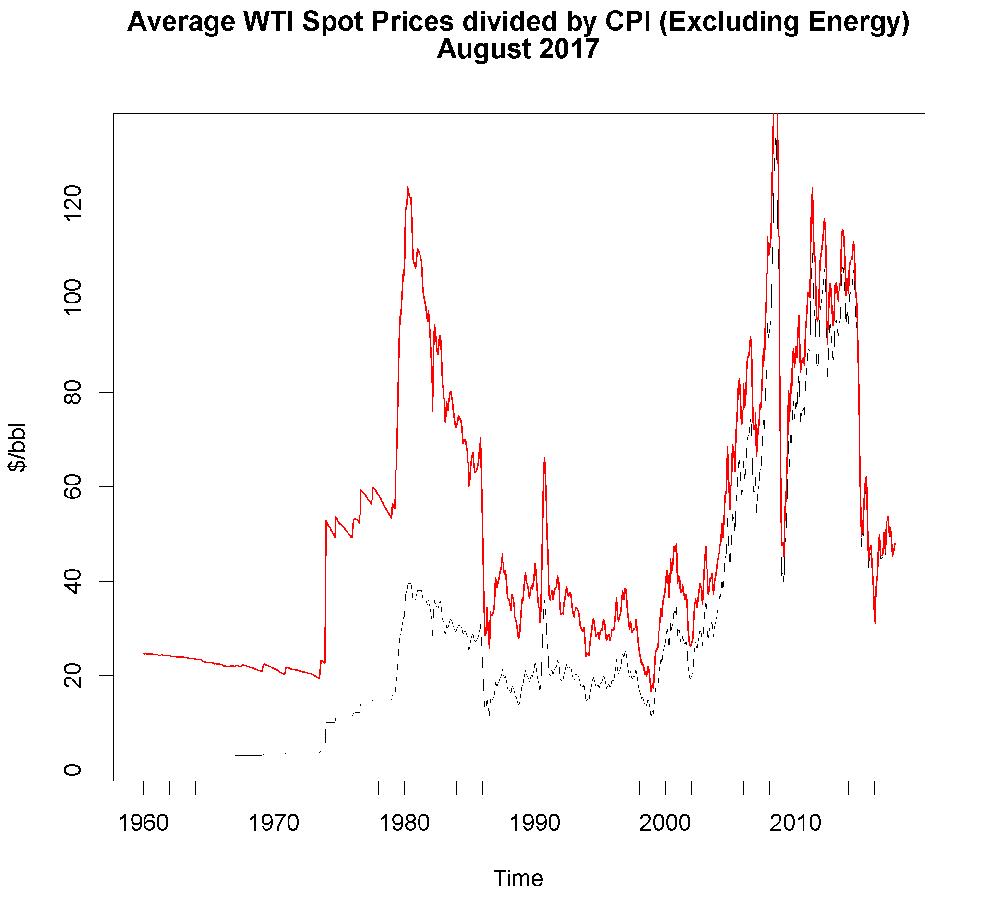
Longer-Term Oil Prices
This is the inflation adjusted price
This is a 68% confidence interval
This is the mean reverting price

Slide 68
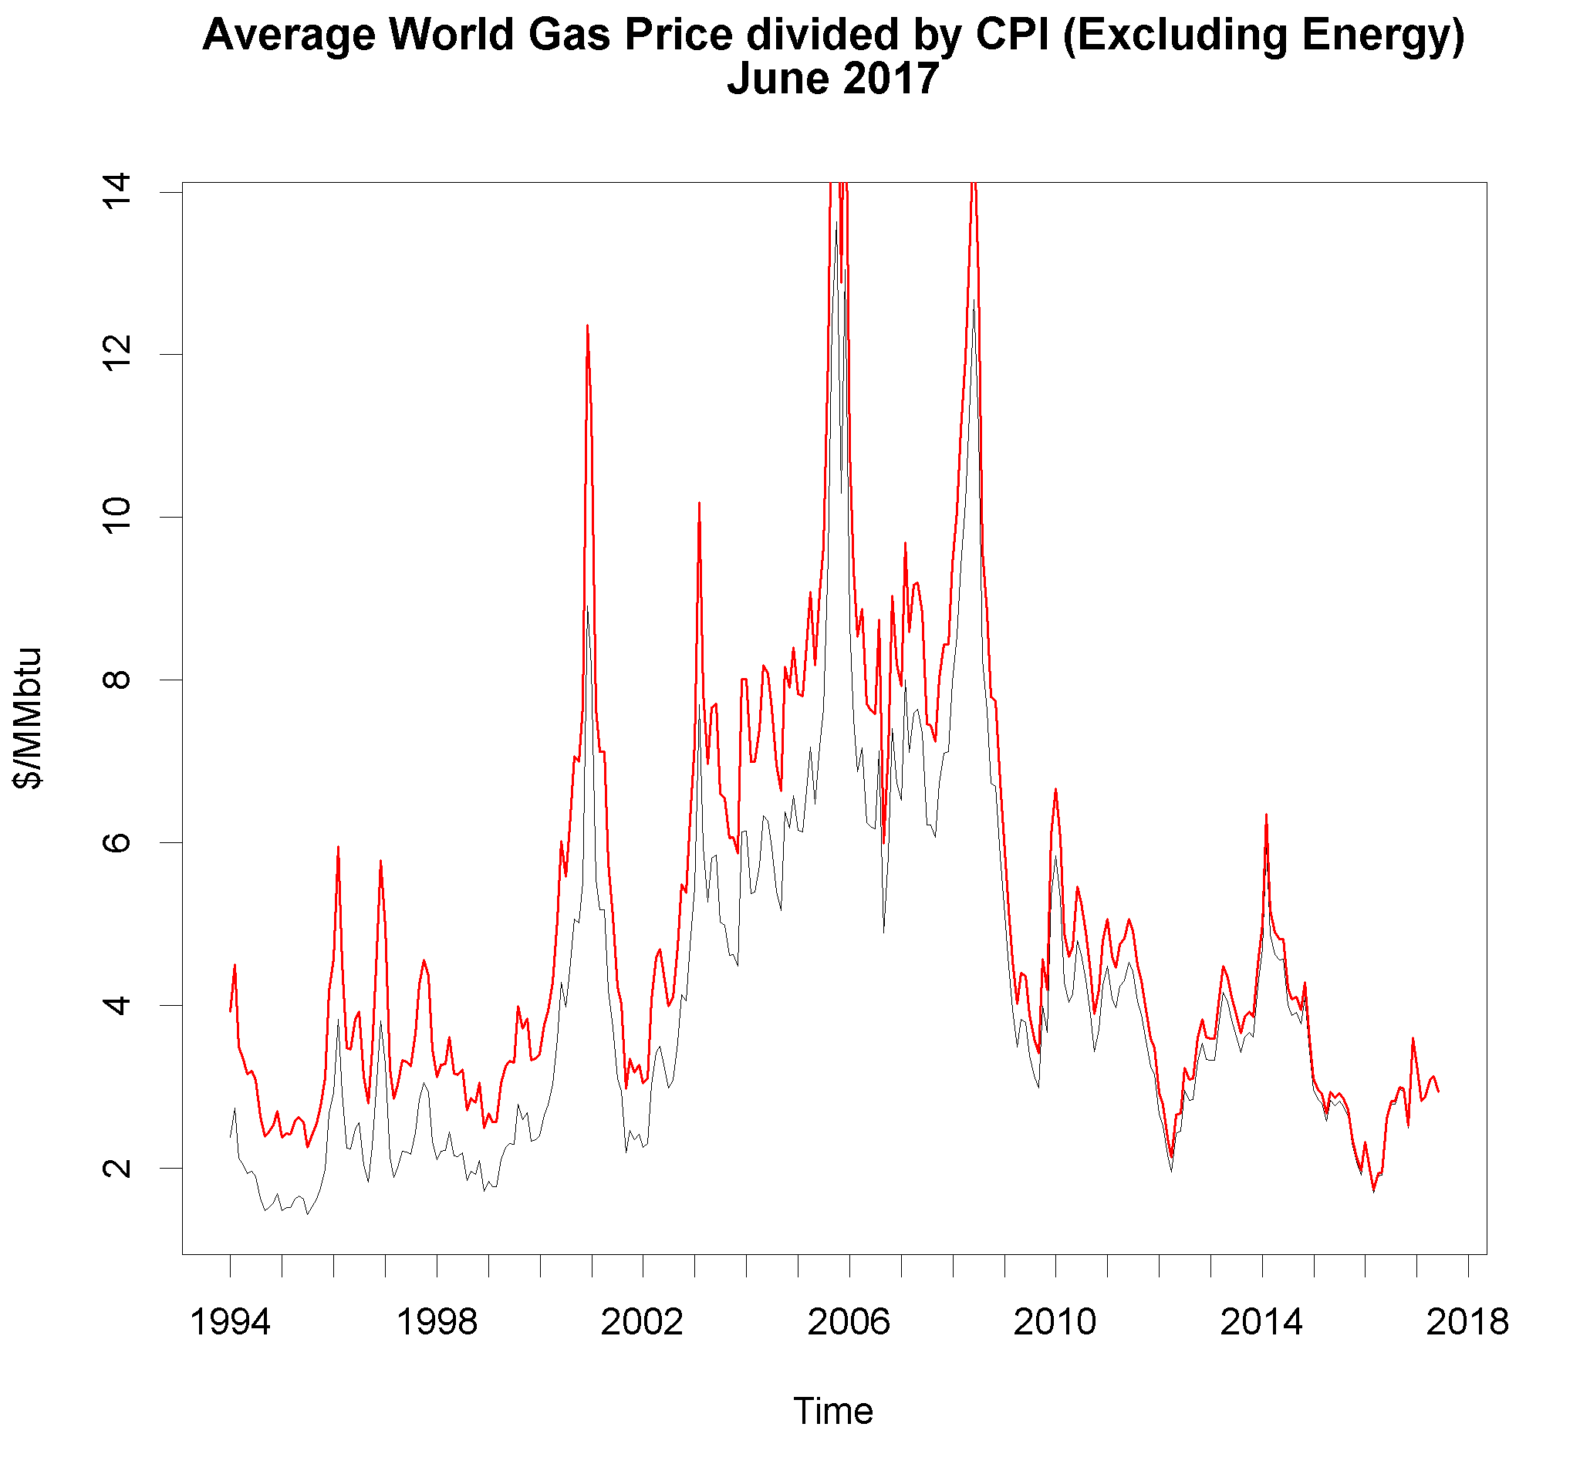
Longer-Term Gas Prices
This is the inflation adjusted price
This is a 68% confidence interval
This is the mean reverting price

Slide 69


Comparison To Regional Trends (Well Productivity)
We start with an overall scan of the Montney, looking at all offset production

Slide 70
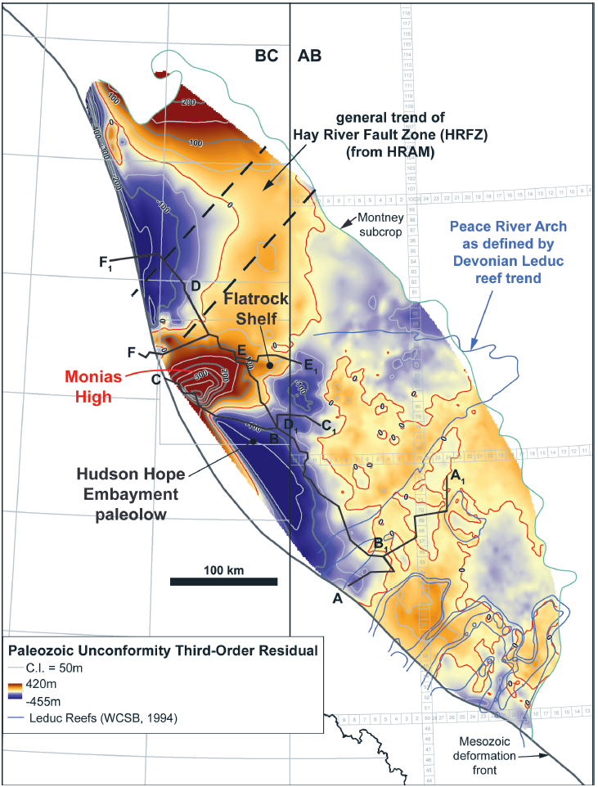
Base of Montney Structure Map
Structure Map of the base of the Montney showing areas where basin is deeper (blue) and shallower (red)
The thickest deposits are found in the deeper areas.
Canadian Discovery Ltd. and CSPG Bulletin Vol 66 N01

Slide 71
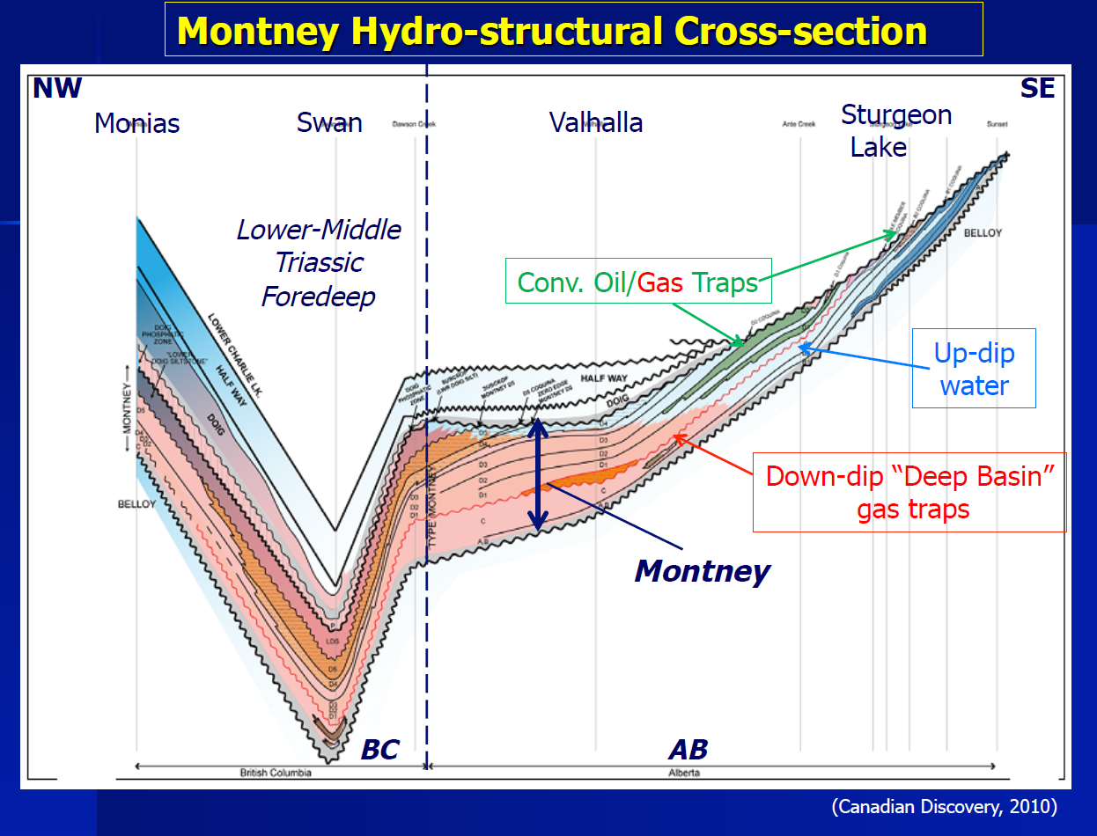
pressure Regime
Overpressured unconventional reservoir west of the deep basin boundary
Low to regularly pressured conventional reservoir east of the boundary
Areas of active development in the unconventional Montney tend to be in the yellow-orange regions.
approximate Deep Basin boundary
~3500-5500 psia
~2000-3500 psia
X-section
~6500-7500 psia
(Canadian Discovery)
Notes:
Simple description of deep basin gas trap
boundary is where the pressure is approximately equal to the water gradient

Slide 72
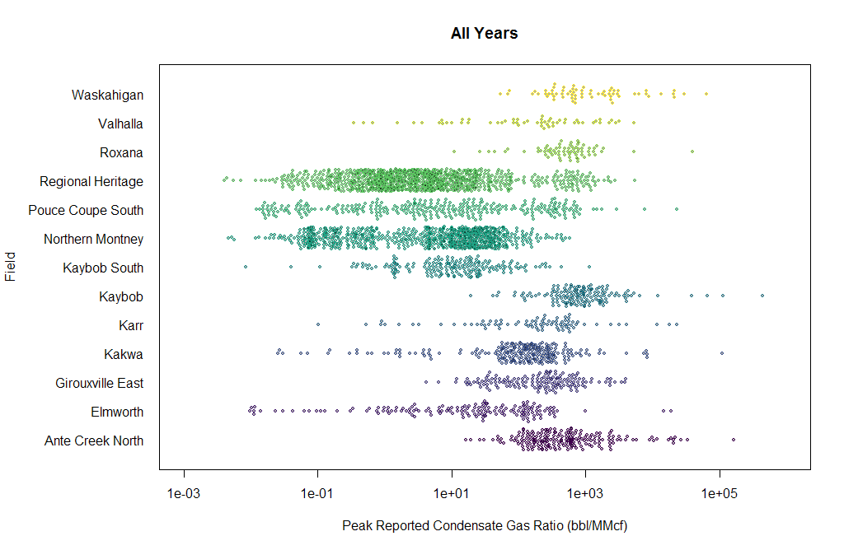
We Know that Different Areas have Different Liquid Yields

Slide 73
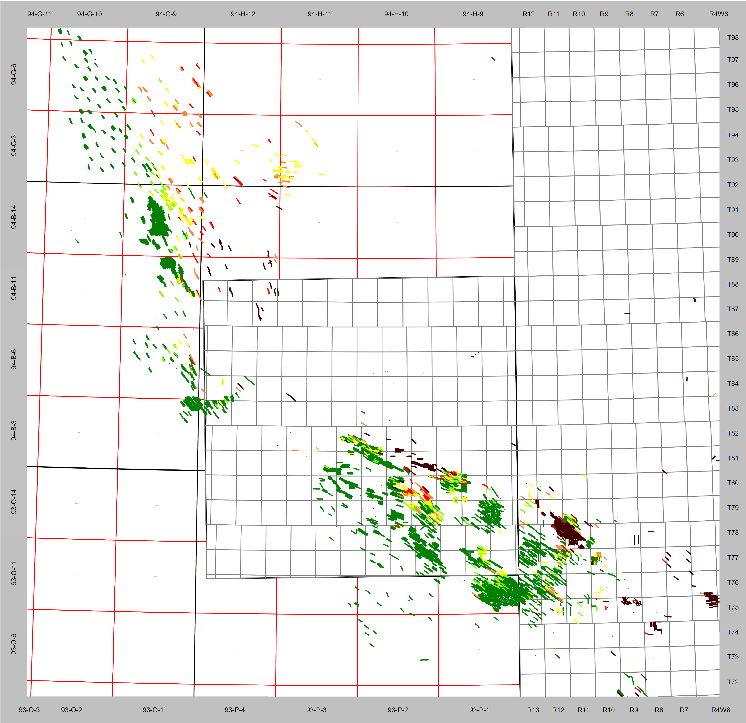

Montney CGR Trends

Slide 74






Yields are Related to Phase Envelope of Recombined Samples
00/05-10-079-12W6/0
00/10-24-079-15W6/0
00/12-29-077-13W6/0
00/04-27-077-15W6/0
02/05-14-075-09W6/0

Slide 75

Comparison To Regional Trends (Initial Condensate Gas Ratio)
Crew Groundbirch

Slide 76
Comparison To Regional Trends (Initial Condensate Gas Ratio)
The transition from gas to liquids to oil is not even, but shows fingering effects

Slide 77

Rate-Time Plot of Montney Wells (Groundbirch)

Slide 78

Montney Summary: Variability in EUR Between Wells
Red= high variability (in EUR) between wells within region
Green=low variability (in EUR) between wells within region

Slide 79

Montney Gas in NE British Columbia (Rate-Time Plot)

Slide 80
Production Forecasts using
SPEE Monograph 4 Methods
Two-stage Arps hyperbolic declines
Bootstrap resampling
Flow regime diagnostics

Slide 81

Sample Detailed RTA Dashboard
Please note how an excellent, though different, match was obtained on every single plot. This is typical of resource plays under transient flow. Proper analysis requires developing a model that explains how the flow regime changes over time so that a global match can be obtained.
Please also note that superposition time makes production resemble whatever flow regime is baked into the superposition function.

Slide 82


Groundbirch WELLS VS Type Curve
02-05 is 1600m long and A02-04(03-05) is 2100m. Both wells used 65ton/stage and ~25 stages of frac. Type well is 2500m

Slide 83


PENGROWTH WELLS VS Type Curve
Pengrowth used higher frac stage count (25 VS 7), 70ton/stage and ~40% more total proppant (1700ton VS 1200ton) in the two 2014 wells. Horizontal well length of 1500m in 2014.

Slide 84


SHELL WELLS VS Type Curve
Shell moved from ~2000m to ~2500m (some over 3000m) long well over the years. Frac stage increased from ~10 to over 40. Proppant/stage decreased from ~130ton/stage to ~50ton/stage.

Slide 85

Montney Wells in NE British Columbia (Decline At 1,2,3,5,10 Years of Production)

Slide 86
Major Concepts
Too often engineers assume the only thing geologists quantify is ɸh… and maybe area.
But… the same geostatistical tools used to make stochastic reservoir models can be used to examine production parameters (such as initial rate, estimated frac length, and EUR).
These tools are numeric so both the best estimate and the uncertainty can be honoured.
More broadly, if the petroleum industry is going to talk in terms of statistics (P10 reserves, average type wells, top tier acreage) it must talk in terms of geostatistics.
For simplicity, this presentation will concentrate on just one parameter, gas EUR.

Slide 87

How an Engineer Plots EUR (Gas Wells in N. America)

Slide 88

How a Statistician Plots EUR (Gas Wells in N. America with IP≈500Mcf/d)
There can be an order of magnitude uncertainty if EUR is est. by Peak Rate

Slide 89

How a Geologist Plots EUR (Gas Wells in WCSB)
Amazing… it may make a difference what side of the mountains you’re on.

Slide 90

Milk River/Med Hat EUR Method 1
Suffield… we’ll see this later

Slide 91

Milk River/Med Hat Gas Remaining
Suffield… we’ll see this next

Slide 92






Suffield MR/MH Gas EUR/mi2
1980
1985
1990
1995
2000
2010
Looking at one of Canada’s original resource plays, we can see that 25 years of technology have added EUR, but have not fundamentally changed the picture… you could say that the geology was important and didn’t change.

Slide 93


Milk River/Med Hat Computer Contours w/ Variance

Slide 94

MR/MH Variograms
The variance N/S is roughly 2.5 at a distance of 100 km.
The variance E/W is roughly 1.5 at a distance of 100 km.
Though we have a fantastic data set and we know the answer, the truth is more complex than our model.

Slide 95

Eagleford EUR Method 2

Slide 96

Eagleford Variograms
The variance N/S is roughly 6.0 at a distance of 100 km.
EUR per well does vary more than in the HSC example, by about a factor of 2-4
The variance E/W is roughly 3.0 at a distance of 100 km.

Slide 97


Eagleford Computer Contours w/ Variance
I included no zero-edge… including wells that are known to have no Eagleford gas would change the answer.

Slide 98

Montney EUR Method 2
Less Development and Production
Earliest Area of Development

Slide 99
Montney Variability in EUR Between Wells
Multiple horizons
High CGR
Mixed vertical and horizontal development
High CGR

Slide 100


Montney Computer Contours w/ Variance
Computer estimates of EURs in these areas are lower.
But estimates in these areas are less certain… as shown by the contour lines.

Slide 101
Drilling Costs

Slide 102
Completion Costs

Slide 103
Montney Cardinality Per Stage

Slide 104

Montney completions
Stage count and IP rate increasing
Proppant per stage and Frac spacing decreasing

Slide 105
Montney Production: Improvement Over Time
There has been a near-continuous improvement in average well performance
These performance changes have been driven by regions of new development and evolving well design.

Slide 106
Per Stage Completion Costs
Costs per completion stage have dropped from ~400 $K per stage to ~90 $K per stage (P50) from 2008 to 2017.
Tonnage per stage has dropped from >200 T to <100 T over the same timeframe.

Slide 107
Per m Drilling Costs
Drill costs per meter have fluctuated between 600-900$/m
But have stabilized on lower end over last 2+ years

Slide 108
Variable Op Cost Models
The majority of operating costs are variable
We data-mined the op costs in our database, gathering everything from the last 10 years for the 5 plays in this presentation. Costs were pulled in at the well level.
Not all wells were stored in our evaluations. A method was needed to impute missing values.
A random forest algorithm was used to determine the factors most predictive of costs. Using just the main drivers, a model was constructed, again using a random forest algorithm, to estimate missing values.

Slide 109
Variable Op Cost Models
 | IncNodePurity
Year SURFACE_LATITUDE SURFACE_LONGITUDE X_TD_TVD DRILL_TD X_ONPROD_DATE RIG_RELEASE_DATE PROFILE_TYPE COMPLETION_DATE GEOLOGIC_PROVINCE PSUM_FIRST3_OIL PSUM_FIRST3_GAS PSUM_FIRST3_WATER PSUM_CURRENT_STATUS | 865.6 758.4 808.8 501. 3 315.2 185.9 166.9 6.7 177.5 229.9 108.1 126.0 130.2 263. 8
Unsurprisingly, the year and well location were the strongest drivers of variable op costs.
Other factors, such as well status (flowing gas, pumping gas, etc) also had an impact on variable op cost.

Slide 110

Testing the Op Cost Model
The op cost model was tested by splitting the data into training and test sets. The model was fit using the training set then used to predict costs on the test set. Predictions were compared to actual costs. Reasonable matches were observed.

Slide 111


Variable Op Cost Distribution
Montney gas variable costs appear to have settled in their 10 year band. There is some evidence that liquid variable costs are dropping. But this analysis isn’t weighted by production.

Slide 112
Type Curves: Three Slide Summary

Slide 113
Simple Production Forecast: The Short Version
This complex production behavior is approximated by the use of a two stage Arps decline
Stage one is a super-harmonic decline with an “n” exponent that is commonly set equal to 1.4
Stage two is an exponential decline
We continuously examine the validity of this model

Slide 114
Montney Wells in NE British Columbia (Decline At 1,2,3,5,10 Years of Production)
The P50 decline rate for Montney wells at year 10 is approximately 8%/year

Slide 115


Example well (a-B010-J/094-B-09)
Results appear to be stable, especially if there is more than 18 months of production.

Slide 116
Type Curves: Theory and Development

Slide 117

Montney Gas in NE British Columbia (Pseudo-Blasingame Plot)
Flow regime identification:
Green = quarter slope (bi-linear flow)
Red= ½ slope (linear flow)
Black = Unit slope
At this point in time, the vast majority of all Montney wells are still in infinite acting flow.
What evidence we’ve seen for boundary dominated flow is weak and results can often be modelled, with equal data fidelity, as either BDF or infinite acting flow.
Bi-Linear Flow
Linear Flow

Slide 118

Fetkovich BDF Example
4 Montney Verticals Completed in High Perm Channels
Rates are fully normalized to a constant back pressure
Type-curve match was fixed at 18 months, not max rate or initial rate
On a log-log rate-time plot, the slope of the production showed a clear trend… it plummeted once BDF was reached
t* ?
Wells under boundary dominated flow show a distinct production behavior on Fetkovitch plots, and there are a few Montney wells that show this.

Slide 119

Eight Adjacent Hz Gas Wells with Different Early Type Curve Behavior
Rates are fully normalized to a constant back pressure
Type-curve match was fixed at 18 months, not max rate or initial rate
All wells declined… the wells with flat gas rates had declining pressures
Some initial declines were shallow, some were steep
More and more big-frac horizontal wells have shallow declines
Try comparing these declines to the previous plot of four Montney verticals completed in conventional channels
t* ?
Most Montney wells show a different production profile on Fetkovitch plots, one that is typical of transient linear flow.

Slide 120

Montney Gas in NE British Columbia (Rate-Time Plot)
The same linear-transient behavior is observed when average production (aka “type curve”) data is plotted
Survivor Bias and Impact of Older High Productivity Regions
-1/2 Slope

Slide 121

Montney Gas in NE British Columbia (Pseudo-Blasingame Plot)
There is no evidence (or at least very little) of interference between wells
If analytical rate/transient techniques are used for our “type-curves”, damage/skin/clean-up effects start to become apparent
The same results are observed when normalized rates are plotted using “material balance time” or approximations thereof

Slide 122
Operator B Saturn MontNey Pseudo-Blasingame Plot
The same results are observed when plotting individual well results using “material balance time” or approximations thereof
-1/2 Slope
While a few wells might have reached boundary dominated flow, this is not typical, even after years of production
-1 Slope

Slide 123
Production Forecasts using
SPEE Monograph 4 Methods
Two-stage Arps hyperbolic declines
Bootstrap resampling
Flow regime diagnostics
Such transitions are difficult to see on conventional decline plots
Given enough production, and closely spaced wells, a transition to BDF is be observed
Though we have yet to see it in Montney, we anticipate that boundary dominated flow will occur. Thus, we apply decline methods proven to be useful for late-life multi-frac’d oil wells

Slide 124
Operator A Wells Drilled in 2009
These methods require an analysis not just of rate vs time (or cumulative production) but an analysis of the derivative of rate (ie the instantaneous decline “D") and the second derivative of rate (the “b” factor)
This plot shows that “D” is continuously getting smaller, but the slope might be shallowing

Slide 125
Operator A Wells Drilled in 2009
This plot shows that the Arps “b” factor may be decreasing over time (which makes sense because it is tied to the slope of the previous plot) but there is much noise and scatter
Smaller well counts and much noise make it difficult to interpret late life production data

Slide 126
Operator A Wells Drilled in 2010
This plot shows that the Arps “b” factor may be decreasing over time, though not as dramatically as for the previous group of wells
Smaller well counts and much noise again frustrates late life analysis

Slide 127
Operator A Wells Drilled in 2011
This plot shows that “D” is continuously getting smaller, but the slope might be constant

Slide 128
Operator A Wells Drilled in 2011
This plot shows that the Arps “b” factor may be decreasing over time, though not as dramatically as for the previous group of wells.
As with the previous plot, the calculated “b” is approximately equal to 2.0, but decreases with production.
Smaller well counts and much noise

Slide 129
Operator A Wells Drilled in 2012

Slide 130
Operator A Wells Drilled in 2012
This plot shows that the Arps “b” factor may be constant. However, theory and analogy work demonstrates that “b” factors should decrease over time.
Smaller well counts and much noise

Slide 131
Operator A Wells Drilled in 2013

Slide 132
Operator A Wells Drilled in 2013
Smaller well counts and much noise

Slide 133
Operator B Wells Drilled in 2009
These trends in “D” appear throughout the Montney and thus the behavior can be generalized. The long-term behavior of “D” and “b” from one area can, with reasonable certainty, be applied to other areas, even if rates are different.
This plot shows that “D” is continuously getting smaller, but the slope might be shallowing

Slide 134
Operator B Wells Drilled in 2009
This plot shows that the Arps “b” factor is strongly decreasing over time. However, the Montney is this region is much higher perm.
As with the previous plot, the calculated “b” is approximately equal to 2.0, but decreases with production.
Smaller well counts and much noise

Slide 135
Operator B Wells Drilled in 2010

Slide 136
Operator B Wells Drilled in 2010
Again, this plot shows that the Arps “b” factor is strongly decreasing over time. However, the Montney is this region is much higher perm.
Smaller well counts and much noise

Slide 137
Operator B Wells Drilled in 2011

Slide 138
Operator B Wells Drilled in 2011
By 2011, Operator B was developing areas with lower porosity and permeability, areas more analogous to Operator A lands.
The “b” factors still decreased over time, though not as dramatically.
Smaller well counts and much noise

Slide 139

Typical match on Instantaneous Decline
These (post 2010) areas are used as analogies to tune GLJ’s decline models for the Operator A lands.

Slide 140

Typical Match on “b” PArameters
Though much simplified, the “b” factors used by GLJ offer a good match to observed data.

Slide 141
Rigorous Decline Parameter Distributions
Finally, we have tested the results of these Monograph 4 methods using a Markov-Chain Monte Carlo model that uses Bayes Rule to update estimates of “b” as additional production data is obtained.
We are looking to also rigorously calculate the confidence interval (at the well level) for the model parameters
With increasing production, models start converging to sensible best-fit parameters
Here be Dragons! With little production history, most any model can be fit to the data, even models with farcical inputs

Slide 142
Type Curves: Examples

Slide 143
Groundbirch WELLS VS Type Curve
02-05 is 1600m long and A02-04(03-05) is 2100m. Both wells used 65ton/stage and ~25 stages of frac. Type well is 2500m

Slide 144
PENGROWTH WELLS VS Type Curve
Pengrowth used higher frac stage count (25 VS 7), 70ton/stage and ~40% more total proppant (1700ton VS 1200ton) in the two 2014 wells. Horizontal well length of 1500m in 2014.
Moreover, these wells were completed simultaneously and potential benefitted from constructing frac interference

Slide 145
SHELL WELLS VS Type Curve
Shell moved from ~2000m to ~2500m (some over 3000m) long well over the years. Frac stage increased from ~10 to over 40. Proppant/stage decreased from ~130ton/stage to ~50ton/stage.

Slide 146

SHELL WELLS VS Type Curve
Painted Pony tested drilling at tight well spacing, less than 300 m, near existing wells. Frac communication was observed between wells, both new and old, and the production of existing wells was curtailed
It is important to conduct pilot tests before embarking on any major change of drilling or completion design.

Slide 147
Determination of 1P/2P/3P Spread

Slide 148
GLJ’s 1P/2P/3P spread in Brief
We establish our best-estimate (2P) EUR estimates for each well using the methods previously described
We then deterministic ratio to assign low (1P) and high (3P) EURs.
1P will be set at approximately 80% of the 2P estimate (ie 20% lower), 3P will be set at approximately 120% of the 2P estimate (ie 20% higher).
The 1P, 2P and 3P estimates are all rounded to an even value, perhaps the nearest 100 MMcf or 250 MMcf value.
We have compared this to ratios suggested by statistical aggregation methods, but have reservations in using such methods on Operator A lands at this time.

Slide 149
All Operator A Montney Wells
A simple analysis of all Operator A wells indicates that P10/P90 ratio is approximately 4.

Slide 150
Operator A Upper Montney Wells
Similar results are obtained if just the Upper Montney wells are considered…

Slide 151
Operator A Middle Montney Wells
…or the Middle Montney…

Slide 152
Operator A Lower Montney Wells
…or the Lower Montney. When the ratio is calculated at the individual property level, the ratio is between 3 and 6.

Slide 153

Statistical Aggregation
Given the apparent consistency in P10/P90 ratio, one might consider using the aggregation methods proposed in SPEE Monograph 3.
If all requirements are met, doing aggregation the Monograph 3 way is very easy. You simply need to calculate the ratio between your P10 and P90 EUR estimates, tally up your number of locations and then look up the factor you need to multiply your P50 EUR estimate by in order to get your P90 EUR.
Unfortunately, Monograph 3 doesn’t provide detailed guidance on how to calculate EUR, how to calculate the number of locations or what to do if estimates of P10 and P90 are uncertain.

Slide 154
Statistical Aggregation
Blindly applying the methods outlined in Monograph 3 would suggest a spread of 10% between the 1P and 2P estimates
However, there are significant technical issues with this
The distributions do not show homoscedasticity
Applying the “anchor well” method would require length scales unacceptably large given observed correlation distances
Secondary uncertainties, such as the impact of faulting, are not captured
Some of these technical issues will be outlined in the following slides.

Slide 155

Example of Repeatable Statistical Distribution
The distribution shows a consistent mean and variance
This is for a single formation in a defined area

Slide 156


Monograph 3 “Anchor Well” Method
Monograph 3 advocates the concept of anchor wells and concentric radii.
Statistics must be consistent between radii and around every anchor well
Monograph 3 does not specify what distance the radii should be set at

Slide 157
Distribution of Montney IP30
The distribution shows neither consistent mean nor variance

Slide 158
Distribution of Montney IP30 Around 093-P-09
The distribution still shows neither consistent mean nor variance
This is a result of both the early stage of delineation of the play and the continuous changes in drilling and completion design.

Slide 159
Consideration of Correlation Distance
The closer wells are located to one another, the more likely they are to have the same productivity.
This relationship is often expressed as it’s inverse: the closer the wells are located, the less variance between them.
Variograms can be used to quantify these trends.
The distance at which wells start to become more correlated (less variance) appears to be roughly 2400m (1.5 miles)

Slide 160
Relating Reserves Bookings to Correlation Scales
Using this distance of 1.5 miles, regions were assigned 2P reserves if control points were spaced no more than 3 miles away: each control point was at the limit of what could be demonstrated to have statistical bearing on a well’s expected productivity
Regions were assigned 1P reserves if control points were no more than 1.5 miles away: the region was entirely within a distance over which correlation could be expected
1.5 miles
1.5 miles
control point
control point
1.5 miles
control point
control point

Slide 161


Montney 1Proved and 2P Reserve Bookings
6 miles
6 miles
These length scales were used when determining whether to book lands as 1P or 2P.
Proved reserves – green
Proved + Probable - purple

Slide 162

Montney Contingent Resource
6 miles

Slide 163
State of Statistical Aggregation
Operator A's wells are often drilled 3 miles apart.
Thus, the radii around the “anchor wells” would need to be substantially larger than 3 miles to capture enough wells for a meaningful statistical sample… perhaps as large as entire properties. This would of scales larger than justified by geologic processes or results to date.
Completion practices would need to
Thus, GLJ opted to use a larger spread between 1P and 2P, but a spread that was still of comparable scale: 20% (GLJ) vs 10% (naive Monograph 3).
Over time, exploitation drilling is anticipated to provide the data needed to address the technical issues regarding statistical aggregation.

